Slide 1
HFO.com Web Design Ideas
For review and discussion with Diocesan web team

Slide 2
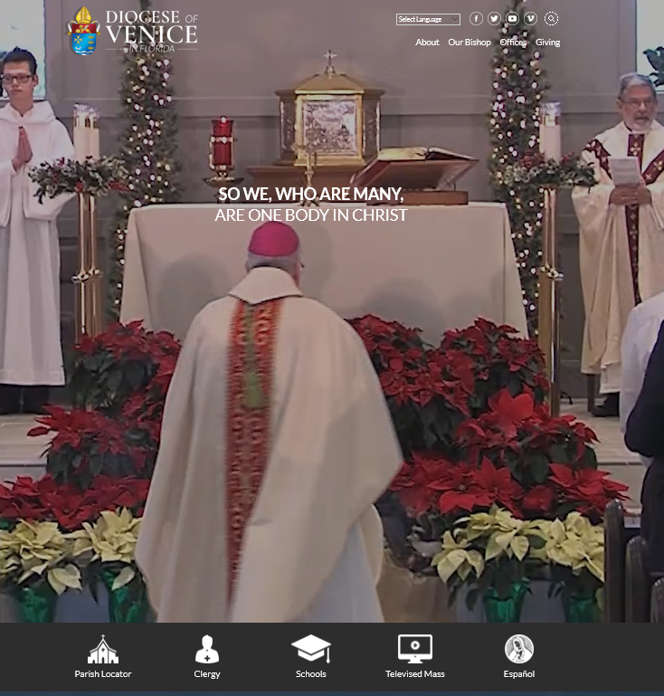
Diocese of Venice
http://dioceseofvenice.org
Action video banner

Slide 3
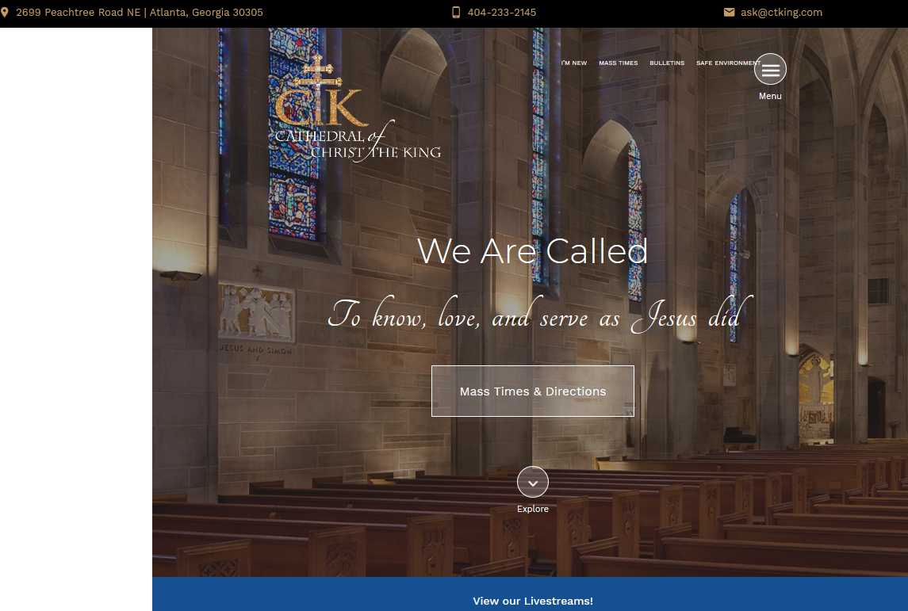
Cathedral of Christ the King
https://cathedralctk.com
Like
Hamburger menu
Auto-collapse??
News & Events Area for Facebook
Facebook Events being on site
Media Center near bottom

Slide 4
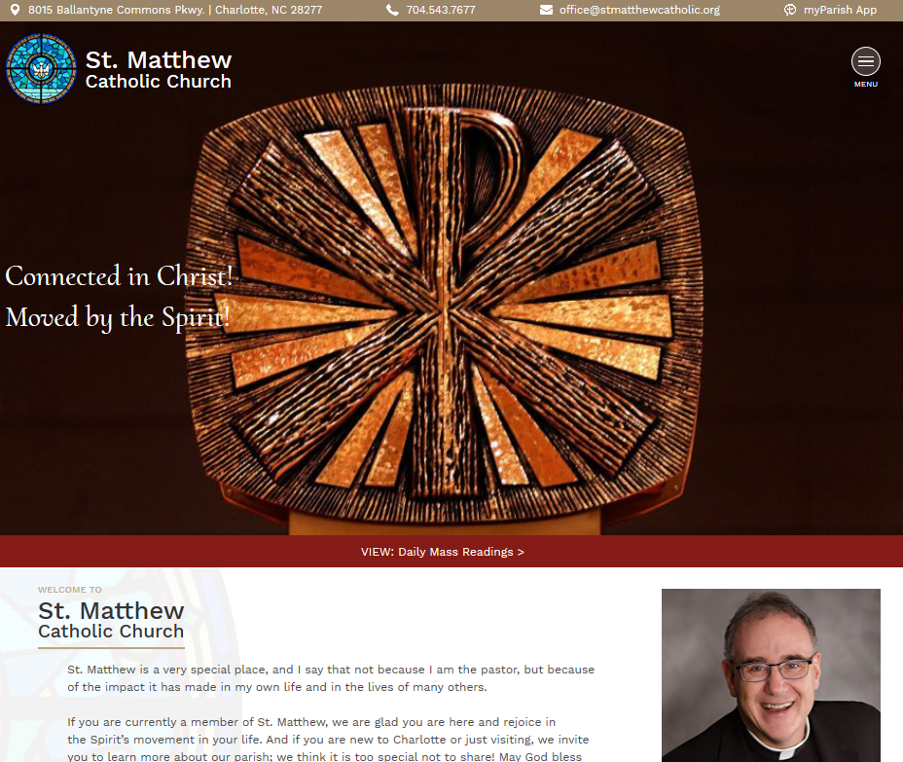
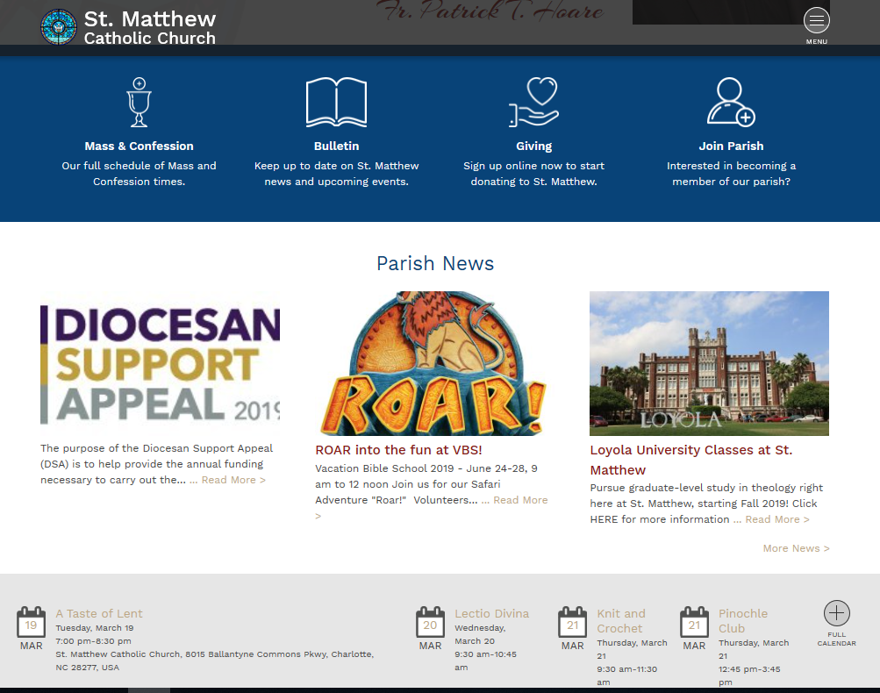
St. Matthew
https://stmatthewcatholic.org
Like
Hamburger menu
Header contact info
Display Homilies via YouTube:
www.holyfamilyorlando.com/CCTN

Slide 5
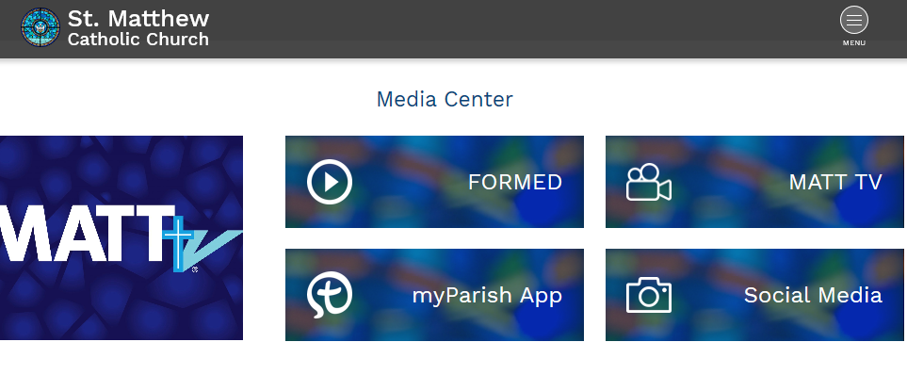

Slide 6
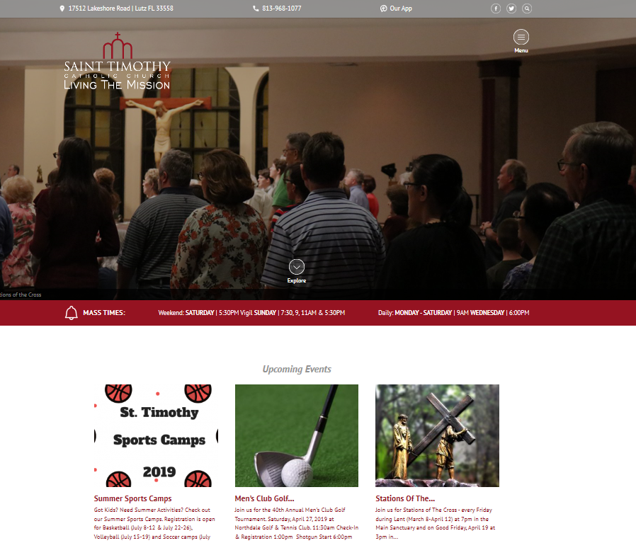
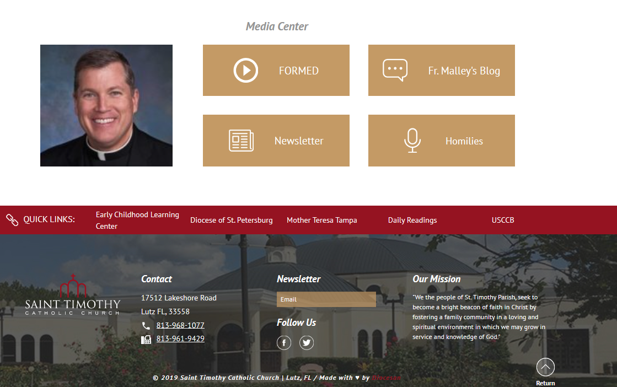
St. Timothy Catholic Church
https://sainttims.org/
Like
Similar to Cathedral CTK
Upcoming Events (posts)
App Messages
Calendar Events

Slide 7
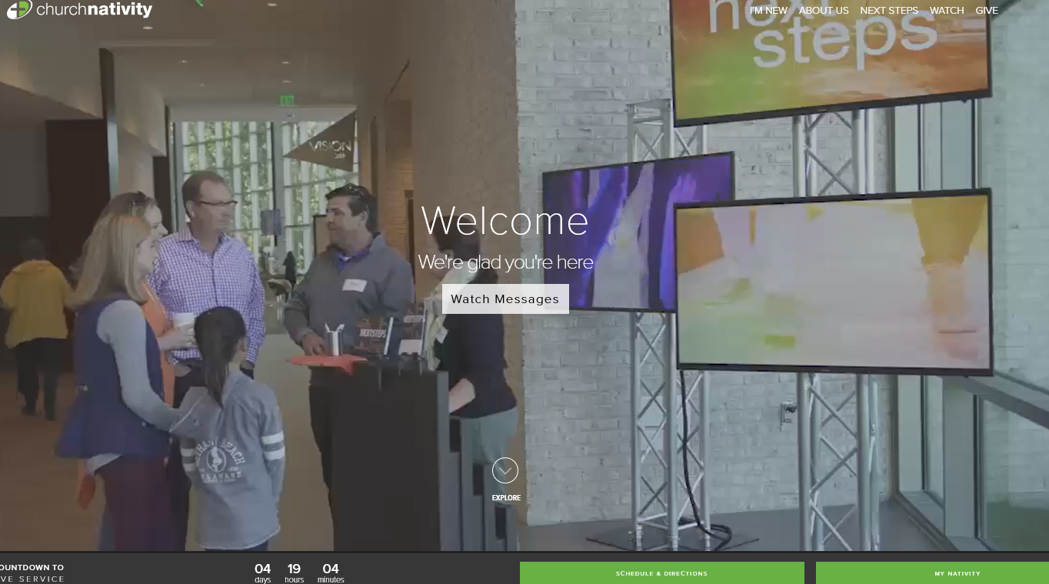
Church of the Nativity
https://www.churchnativity.com/
https://www.churchnativity.com/im-new-2/
Possible CCTN
Heavy Imagery
action videos
Active Parish (boxes display current news/groups)

Slide 8
Home Page
Top bar
address, phone, general email, MyParish app, search bar, social media icons
Banner Bar:
School / CCTN links
Mass Times
Bulletin
Join our Parish
Content:
Welcome!
Bulletin
Calendar
Upcoming Events
Media

Slide 9
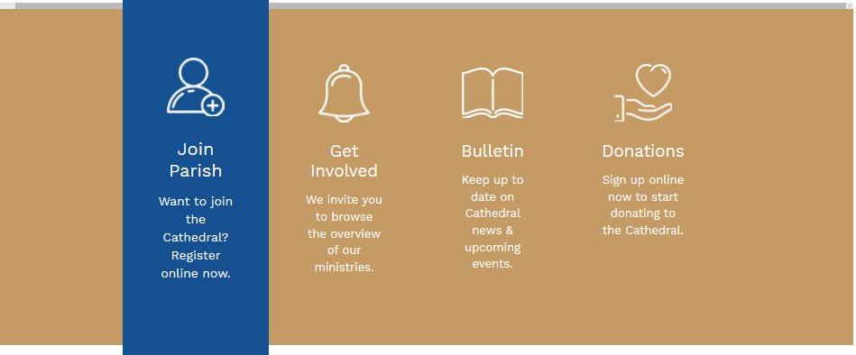
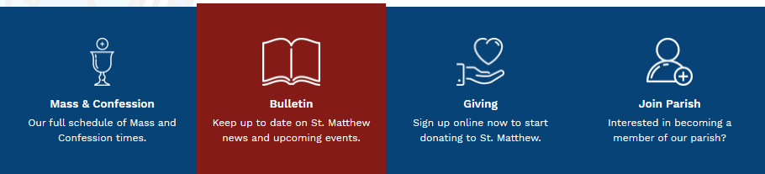
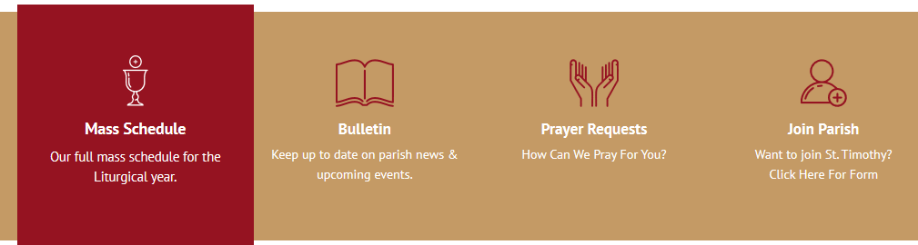
Home Page Elements – callout bar

Slide 10
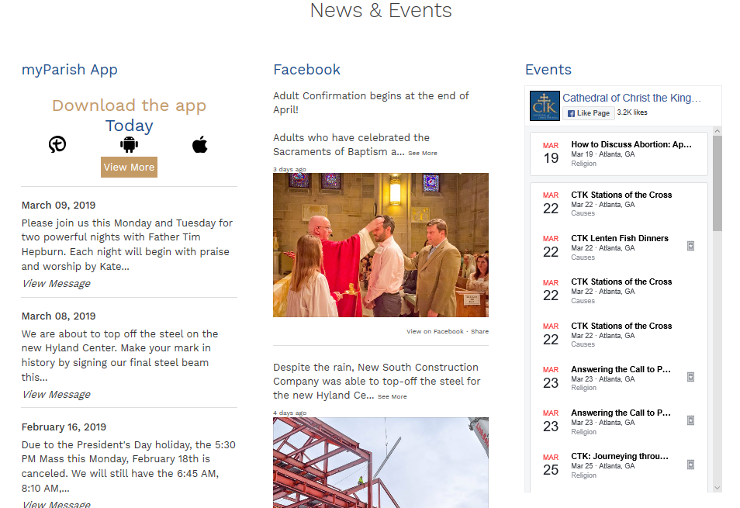
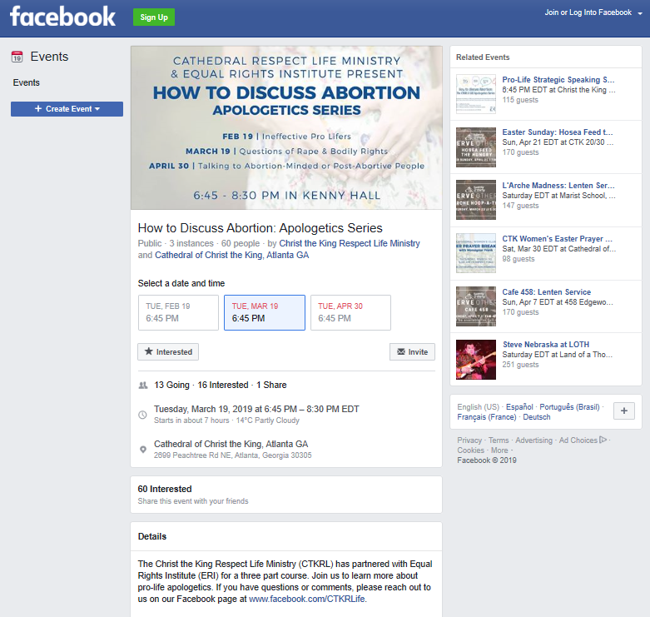
Home Page Elements – News & Events
3-column news & events, but Events in center

Slide 11
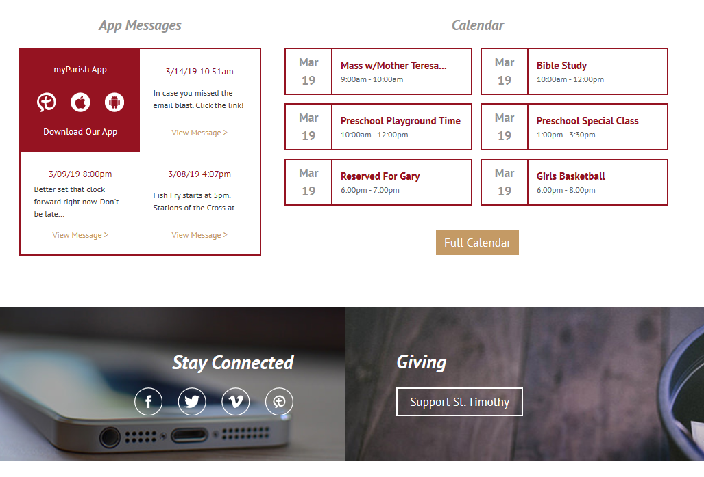
Home Page Elements – Apps, Links, Calendars

Slide 12
Navigation Black Bold: primary nav; Blue: secondary nav; Green: tertiary; Grey: page content ideas
About Holy Family
Join our Parish [Welcome! Link to welcome pkt; welcome desk; link to campus map; registration; link to Get Involved!; link to Team]
History [1974-present; link to Team; link to school, link to Perpetual Adoration Chapel; link to CCTN]
Mass Times & Location
Directions & Campus Map
Nursery during Mass
Homilies & Daily Prayers [link to Parish Posts, etc.]
Parish Team
Meet our Priests [3 profiles]
Pastoral Staff [Deacons; Nuns; Parish Administrative Support]
Safe Environment
Book Store & Gift Shop
CCTN Catholic Community Television Network
Facilities & Scheduling [extranet login for Ministry Scheduler]
Our Catholic Faith
Celebrating the Mass
Liturgy [About the Liturgy; links to ministries; photographic requirements; seasons link; link to homilies; link to music]
Liturgical Seasons [About; photographic requirements; Advent (wreath, colors, etc.); Christmas; Lent (links to Fasting, Prayer, Almsgiving, etc.); Easter/Easter season; Ordinary Times]
Roles in the Mass [add links where appropriate: clergy; EMHC; Ushers; Altar Servers; Lectors/Readers; Music (cantor, choirs, musicians); children’s liturgy/CLoW; liturgical environment/preparation; sacristans; congregation]
The Sacraments [What is a Sacrament?; links to each]
Baptism [Infant; RCIA (Children over 7 yrs) & Adult; photographic guidelines]
Reconciliation/Confession
Holy Communion [Catechumenate/Full Communion; RCIA; photographic guidelines]
Confirmation [photographic guidelines]
Marriage [photographic guidelines]
Anointing of the Sick
Holy Orders
Pastoral Care [Spiritual Direction; Healing Support Groups; link to St. VdeP]
Funerals & Bereavement
Ministry to the Sick/Homebound
Catholicism Today [What is the Catholic Church?; Being Catholic Today; Prayer; link to Faith Formation; links to other resources]

Slide 13
Navigation Black Bold: primary nav; Blue: secondary nav; Green: tertiary; Grey: page content ideas
Faith Formation [What is…, breakouts, who to contact, calendars, links]
Becoming Catholic - RCIA
Adults [About…; links to Bible/Book Studies; link to Dynamic Catholic; Others?]
Young Adults [About…]
YAM – Young Adult Ministry
Youth
Ignite (HS)
Wildfire (HS)
Credo (HS)
Children [About…]
Sunday School (pre-K)
VBS - Vacation Bible School (pre-K thru 5th)
CIT - Counsellors in Training (6th thru HS)
PREP - Parish Religious Ed Program (K thru 8th) [Spark (middle school)]
Vocations
Giving Back [Pay it Forward?] [Envelopes, etc.; Legacy/bequests; Bulletin ads; link to Online Giving; link to Get Involved!]
Stewardship [link to Get Involved! and Giving Back]
Capital Improvements
Diocesan Appeals
Online Giving

Slide 14
Navigation Black Bold: primary nav; Blue: secondary nav; Green: tertiary; Grey: page content ideas
Get Involved! [time, talent, treasure; chart of ministry/group attributes]
Ministries and Groups
Liturgy & Worship [Altar Servers; Audio-Video & CCTN; Baptism Garments/Sewing Guild; CLoW Children’s Liturgy of the Word; EMHC; EMHC to Sick/Homebound; Liturgical Environment Preparation; Ministers of Hospitality/Ushers; Ministers of the Word/Lectors; Music Ministry; Perpetual Eucharistic Adoration; Sacristans; VBS Vacation Bible School]
Faith Formation [links to FF areas]
Prayer & Spirituality [Bereavement Groups; Bible Study Groups; Dynamic Catholic Book Study; Men/Women Emmaus; Healing Hands of Jesus; Holy Face of Jesus Devotion; Holy Spirit Prayer Group; KofC Rosary; Lay Carmelites; Legion of Mary Rosary; Marian Movement of Priests; Mary’s Rosary; Regnum Christi; Vocations Chalice]
Stewardship & Evangelization [Parish Council; CCTN volunteers; St. Vincent de Paul
Parish Community [A Stitch in Time; Coffee & Donuts; CCW Council of Catholic Women; Dinner @ 7; Fall Festival; Fil-Am Filipino-Americans; Forge; Fun After Fifty; Helping Hands; MoHF Men of Holy Family; MoPS Mothers of Pre-Schoolers; Parish Council; Respect Life; Scouts]
News & Events
Bulletin
Calendar
Events
Articles/Blogs [social media links]
Parish Posts [parishioner profiles? Daily Affirmations? Quizzes, surveys, games? Parishioner prayers and pictures? original or attributed prayers, pix of churches, drawings, spiritual locations, etc.]
Contact Us [link to Directions & Campus Map; link to Parish Team; link to Parish Council]

Slide 15
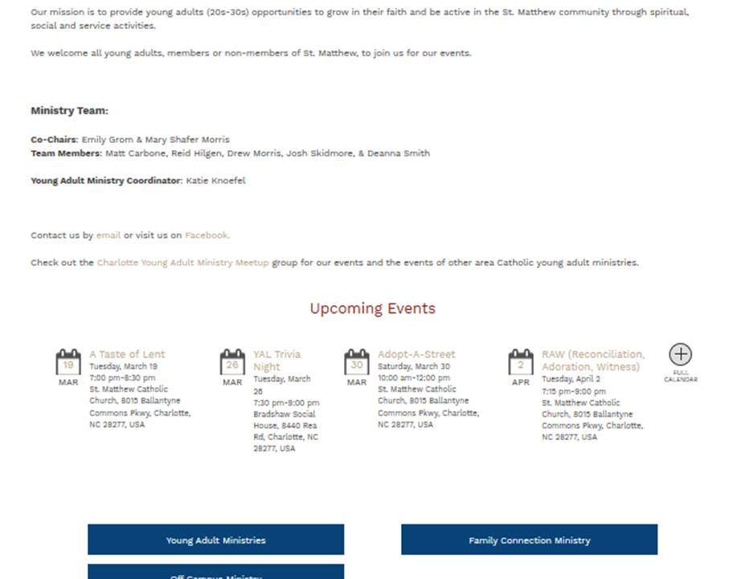
Page template ideas
Simple statement and key info copy
Upcoming events calendar specific to group
Link blocks (w/icons?)
Photo Gallery option

Slide 16
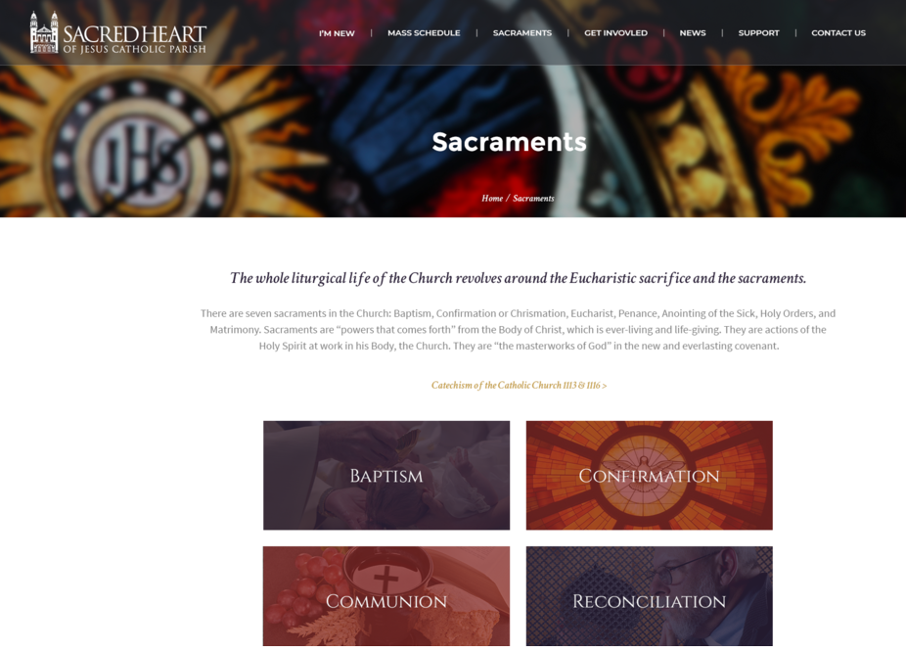
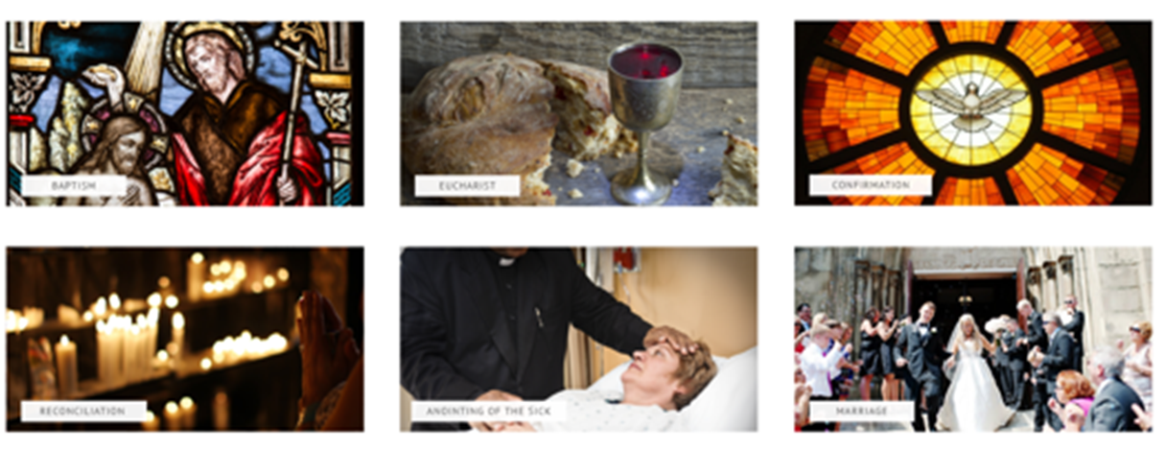
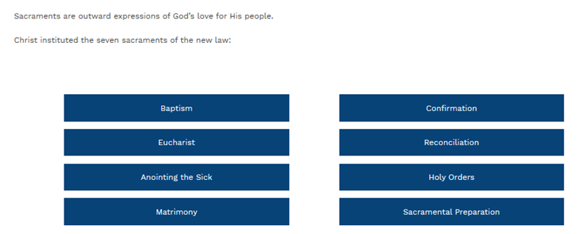
Link with…
Simple bars for ministry sub-heads; copy links for ministry names
Image buttons
Text above buttons

Slide 17
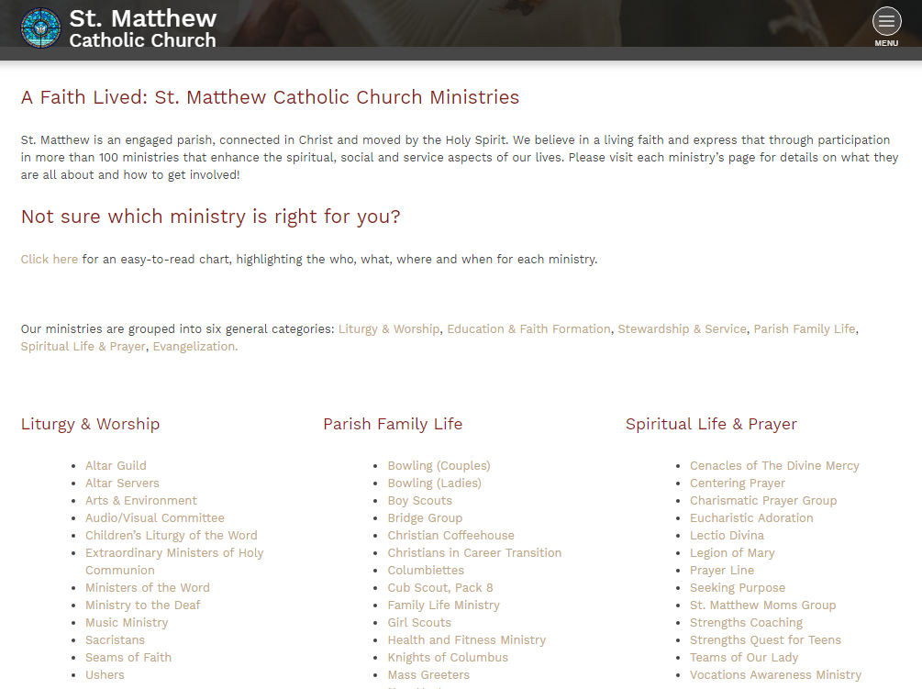

Slide 18
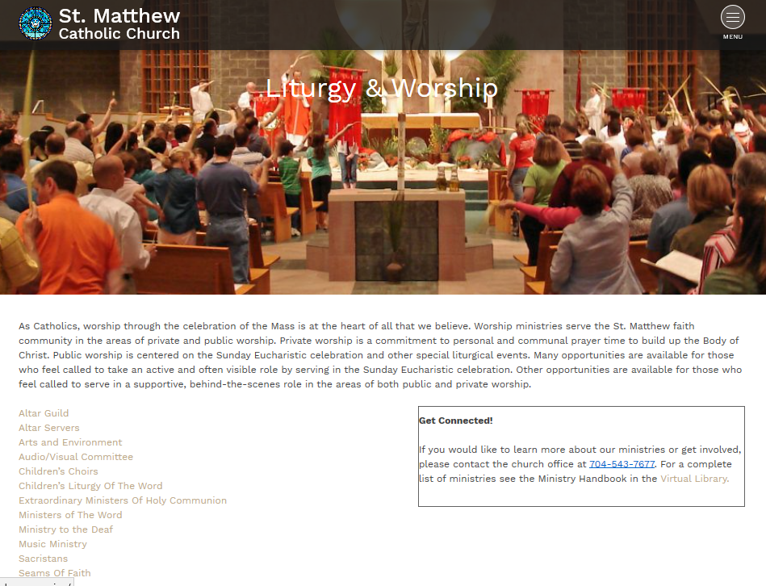

Slide 19
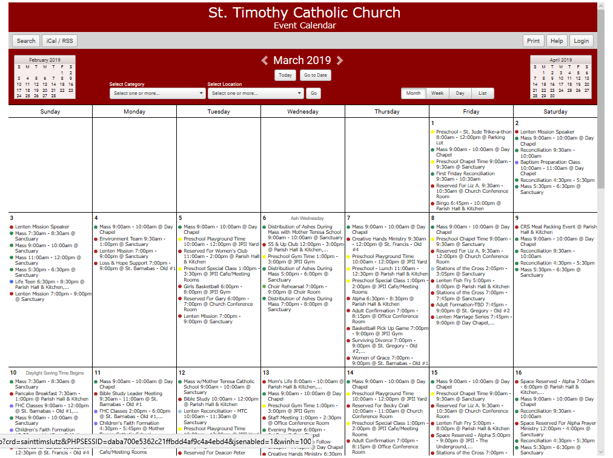

Slide 20
Branding Idea
Color scheme: (horizontal transition?) from deep blue to aqua blue-green to green
Deep blue to signify heavenly skies
Representative of the Church and our Faith
Blue-green or aqua blue-green to signify the planet and the waters of life
Representative of Ministerial Stewardship or Service
Green to signify the acknowledgment of earthly abundance
Representative of thanksgiving and Educational Knowledge
Logo treatment: Holy Family icon in gold or silver (or white)
Tag line: Faith Stewardship (or Service or Commitment) Knowledge
Brings together church, ministries, school
Fonts: San Serif for copy, Serif for important quotes or prayers

