Slide 1
Training for the
Ministry of Hospitality
Office for Parish Life
Diocese of Scranton

Slide 2

I. Overview of the training
Use the components in any combination & order
The “bare bones” = greeter & usher roles & how-to, w/ prayer/song & commissioning
How ministries fit into broader context: baptismal call & call to be servant leaders
Reflection on spiritual basis for hospitality
Conversation w/ parish pastoral council or session to discern how to expand hospitality ministry in parish
  Other options for the ministry of hospitality,
  Method for a parish group to discern which avenues for hospitality ministry they wish to pursue and
  Encourage larger parish community to see of hospitality as everyone’s responsibility
Notes:
I. Overview of the training
A. Outline of presentation: This training resource is meant to be flexible: its components can be used in any combination and order as the presenter sees fit.
It offers the “bare bones” of teaching the role of the greeter and usher and how they fulfill their ministries, with a prayer/song to start and a commissioning prayer to end.
It also offers the option of adding how these ministries fit into the broader context of everyone’s baptismal call to minister and of Bishop Bambera’s call to be servant leaders.
The resource also offers several avenues for reflection on the spiritual basis for hospitality, which is the foundation for actually being hospitable. These could be woven into the above topics or stand alone as a separate session.
Furthermore, the resource lays out
other options for the ministry of hospitality,
a method for a parish group to discern which avenues for hospitality ministry they wish to pursue and
how to encourage the larger parish community to see the ministry of hospitality as something everyone is responsible for.
This could stand alone as a conversation with parish pastoral council or be a session the participants do at the end of the rest of the training to discern how to expand hospitality ministry in their parish.

Slide 3

II. Introduction
Deep roots: Abraham & Sarah welcome 3 angels
  Hospitality = value in Bedouin culture
  Scripture: part of God’s generosity → religious requirement
Broad range of activities, attitudes and behaviors.
  Traditionally: ushers & greeters
  Newer: parking team or information team
  Also: way parish community acts/speaks
Transformative
  Jesus saw each person for who they were→ transformed into disciples
  Likewise, we welcome those who come to worship → feel they belong → frees them to enter into mystery of Eucharist.
So, hospitality = necessary prerequisite for “full, conscious and active participation” in the liturgy.
Notes:
The ministry of hospitality has deep roots in our tradition, going back to Abraham and Sarah’s gracious welcome of the three angels at Mamre (Gn 18: 1-8). Travelers had no other recourse to get food, shelter and safety but the kindness of those who lived along the travelers’ route. So hospitality became a central value of Bedouin culture. Scripture ties it to the generosity of God, making it a spiritual and religious requirement as well. (See, for example, the Parable of the Last Judgment in Mt 25:31-46)
The ministry of hospitality also covers a broad range of activities, attitudes and behaviors. One first thinks of the formal roles of ushers and greeters. The ministry of hospitality has broadened recently to include some newer ministries, such as a parking team or information team. However, it also includes the way the whole parish community acts towards and speaks with one another.
When we are welcoming toward others, we imitate Jesus who truly saw each person who came before him for who they were, namely someone to love. This attentiveness transformed Zaccheus, Andrew, the Woman at the Well and many others. It can likewise transform those who come to worship with us so that they feel they belong to the Body of Christ. This sense of belonging and being loved frees them to enter into the mystery of the Eucharist. So, the ministry of hospitality is a necessary prerequisite for “full, conscious and active participation” in the liturgy. (Constitution on the Liturgy, art. 14)

Slide 4
III. Prayer
A. Suggested hymns/songs
“A Place at the Table,” Lori True
“All Are Welcome,” Marty Haugen
“Christ Has No Body Now But Yours,” Steven C. Warner
“Come to the Feast,” Marty Haugen
“Come to the Water,” John Foley SJ
“Gather Us In,” Marty Haugen
“Gathered as One,” Deanna Light
“God Has Chosen Me,” Bernadette Farrell
“Table of Plenty,” Dan Schutte
“We Are the Light of the World,” Jean A. Greif
“We Come to Your Feast,” Michael Joncas
Notes:
III. Prayer
Because this is training for ministry, it is most helpful to include prayerful reflection in the training. Here are some songs, prayers and reflective exercises the instructor can use. They can be used at the beginning or ending of each session. Another option is to use these during the session to break up the flow of information with reflective time so that participants can absorb and prayerfully ruminate on what they are learning. There are also some suggestions for blessing the ministers at the end of their training. Some prayers obviously are to be sent home with the participants to use when they are getting ready to minister.

Slide 5
To Start or End the Session
“The Breastplate of St. Patrick”
Christ, be with me,
Christ before me, Christ behind me,
Christ in me,
Christ beneath me, Christ above me,
Christ on my right, Christ on my left,
Christ where I lie,
Christ where I sit,
Christ where I arise,
Christ in the heart of everyone who thinks of me,
Christ in the mouth of everyone who speaks of me,
Christ in every eye that sees me,
Christ in every ear that hears me.
Salvation is of the Lord.
Salvation is of the Lord.
Salvation is of the Christ.
May your salvation, Lord, be ever with us.

Slide 6
Start or End, cont.
Hospitality Prayer #1
Lord, give us the eyes of Jesus to see our neighbors and the strangers we meet. Teach us what it means to love the stranger as we love ourselves. Forgive us for our selfishness, for our silence, for not caring enough for the strangers who come to our communities. Teach us to love and care for the stranger the way you do. Amen.
-Rebecca Jiménez Yoder
Hospitality Prayer #2
Welcoming and gracious God, whose love and compassion are boundless, place in us a desire to greet each person we meet with the same love, compassion, and respect we would show to you. Help us to see your face in every person, and to serve your people with dignity and care. Bless us as we seek to love as you loved, and serve as you served. We ask this through Jesus Christ, our Lord.
-Archdiocese of Cincinnati

Slide 7
“How Welcoming Am I?”
The hospitable person
  I am a welcoming presence in my parish.
  I am welcoming in my facial expressions and mannerisms.
  I see Christ in others. Do others see Christ in me?
  I greet people as I approach the church.
  I greet people in the gathering space of the church.
  I make a conscious decision to speak positively about the Catholic Church, my parish, my pastor, etc.
  I am inclusive.
  I make a conscious effort to participate in the Mass to give glory to God and give good example to others.
  I extend Christ’s peace to others, looking them in the eye and acknowledging everyone around me.
Consider prayerfully :
  A strength you bring to the ministry of hospitality
  An area you’d like to develop
Notes:
“How Welcoming Am I?” --a reflective prayer that can be used for faith sharing OR by oneself
Read through and reflect on this description of a hospitable person
I am a welcoming presence in my parish.
I am welcoming in my facial expressions and mannerisms.
I see Christ in others. Do others see Christ in me?
I greet people as I approach the church.
I greet people in the gathering space of the church.
I make a conscious decision to speak positively about the Catholic Church, my parish, my pastor, etc.
I am inclusive.
I make a conscious effort to participate in the Mass to give glory to God and give good example to others.
I extend Christ’s peace to others, looking them in the eye and acknowledging everyone around me.
Consider prayerfully (optional: during reflection, play JM Talbot’s “Christ Has No Body Now But Yours”)
A strength you bring to the ministry of hospitality
An area you’d like to develop
If you are doing this with a group, invite people to share, if they are comfortable, what they have realized. If the group is large (10+) or the time is short, just ask people to share with the person next to them.

Slide 8

Commissionings
Congregational Blessing for Ushers or Ministers of Hospitality: see chapter 62 in The Book of Blessings
Blessing of Ministers of Hospitality/Ushers:
O God of divine welcome and hospitality, who calls us together with praise and thanksgiving in the Mass, bless these men and women who serve your people as ministers of hospitality/ushers, greeting each person in a Christ-like manner, directing processions in your honor and as a community of faith, and collecting the gifts of your priestly people. Form them to be prayerful, patient, helpful, and understanding in their service to others. Gift them with a friendly and pleasant spirit to those they greet in the mass and throughout their day. In thanksgiving for their service as hospitality/usher ministers we ask this prayer of blessing through Jesus Christ your Son, who lives and reigns with you in the unity of the Holy Spirit, one God forever and ever. Amen.
-Archdiocese of Cincinnati
Notes:
Congregational Blessing for Ushers or Ministers of Hospitality: can be found in chapter 62 in The Book of Blessings -“This order may be used during Mass or in a celebration of the word of God. This blessing is normally given by the pastor. If necessary, he may delegate another priest or deacon to give the blessing.” (1850-51)
Blessing of Ministers of Hospitality/Ushers: O God of divine welcome and hospitality, who calls us together with praise and thanksgiving in the Mass, bless these men and women who serve your people as ministers of hospitality/ushers, greeting each person in a Christ-like manner, directing processions in your honor and as a community of faith, and collecting the gifts of your priestly people. Form them to be prayerful, patient, helpful, and understanding in their service to others. Gift them with a friendly and pleasant spirit to those they greet in the mass and throughout their day. In thanksgiving for their service as hospitality/usher ministers we ask this prayer of blessing through Jesus Christ your Son, who lives and reigns with you in the unity of the Holy Spirit, one God forever and ever. Amen.
-Archdiocese of Cincinnati

Slide 9
Before Ministering
Prayer before Ministering #2
Lord, in your love you gather your people this day; help me to serve them in a Christ-like manner, even as your son Jesus served those who gathered about him. Make me prayerful, patient, helpful & understanding, & may I radiate the joy that faith brings as I serve their needs. Give me your strength to support my fellow ministers. May all who assemble to celebrate our common faith in the risen savior be glad of heart for being here and for having encountered your son in one another, in our priest, at the tables of the book and the bread, and through the ministry of ushers like me. I ask this in Jesus’ name. Amen.
-Gregory F. Smith, O. Carm
Prayer before Ministering #1
Heavenly Father,
You sent your Son as a model for hospitality and ministry.
May I have the courage to walk in his ways and serve your people.
Prepare my heart to love all who come through the door today.
Give me eyes to see their needs and gifts,
and grace to respond wisely to each situation.
I ask this through the same Jesus Christ our Lord.
Amen.
-Ferrell & Turner, Guide for Ushers & Greeters
Notes:
Prayer before Ministering #1
Heavenly Father,
You sent your Son as a model for hospitality and ministry.
May I have the courage to walk in his ways and serve your people.
Prepare my heart to love all who come through the door today.
Give me eyes to see their needs and gifts,
and grace to respond wisely to each situation.
I ask this through the same Jesus Christ our Lord.
Amen.
-Ferrell & Turner, Guide for Ushers & Greeters
Prayer before Ministering #2
Lord, in your love you gather your people this day; help me to serve them in a Christ-like manner, even as your son Jesus served those who gathered about him. Make me prayerful, patient, helpful and understanding, and may I radiate the joy that faith brings as I serve their needs. Give me your strength to support my fellow ministers. May all who assemble to celebrate our common faith in the risen savior be glad of heart for being here and for having encountered your son in one another, in our priest, at the tables of the book and the bread, and through the ministry of ushers like me. I ask this in Jesus’ name. Amen.
-Gregory F. Smith, O. Carm, Quoted by St. Joseph, Keyport, NJ www.stjosephkeyport.org/History%20Ministry%20Of%20Hospitality.pdf retrieved July 17, 2015

Slide 10
V. Understanding of Ministry
  Baptismal Call
    To serve others and to participate in the liturgy
  I Corinthians 12:4-7—different gifts, same Spirit
Each member is called to play a different role
Must discern our gifts and call by God to share those gifts
    Wounded and Loved, Regathering the Scattered
      We are called to lead lives deeply rooted in service—service to our God, neighbor, self, and creation (p. 6).
      Serving, one comes to realize that service to God and neighbor is also an act of leadership that differs in kind and orientation from what normally counts as leadership. Christian disciples lead as a result of faith, not because of personal success or institutional commitment” (p. 6).
Notes:
Where does this understanding of ministry come from? It comes, first and foremost, from our Baptism. Through Baptism, we are first called to serve others, and because of our baptism we also have an obligation to participate in the liturgy of the Church.
St. Paul, in his first letter to the Corinthians, tells us that “There are different kinds of spiritual gifts, but the same Spirit; there are different forms of service but the same Lord; there are different workings but the same God who produces all of them in everyone. To each individual the manifestation of the Spirit is given for some benefit” (I Cor. 12;4-7).
Just as there are different gifts among the members of the Body of Christ, so there are various ministries in the life of the Church. Through prayer and reflection though, we must discern the gifts we have and the call by God to share those gifts with the Church.
In his Pastoral Vision for the Diocese of Scranton, Wounded and Loved, Regathering the Scattered, Bishop Bambera uses the passage of the Footwashing from John’s gospel as the foundation for his vision of servant leadership and tells us, “We are called to lead lives deeply rooted in service—service to our God, neighbor, self, and creation” and ”Serving, one comes to realize that service to God and neighbor is also an act of leadership that differs in kind and orientation from what normally counts as leadership. Christian disciples lead as a result of faith, not because of personal success or institutional commitment.” All of us are called to carry on this servant leadership after the model of Jesus but acknowledging and utilizing the gifts God has given to build the Kingdom.

Slide 11
VI. Role of This Ministry
A. Particular functions
GIRM: ushers & ministers of hospitality among “other functions” lay people may serve
  Those who take up the collections in the church
  Those who, in some regions, welcome the faithful at the church doors, seat them appropriately, and marshal them in processions. (para. 105)
May be commissioned to do so:
Liturgical functions that are not proper to the Priest or the Deacon and are mentioned above may even be entrusted by means of a liturgical blessing or a temporary deputation to suitable lay persons chosen by the pastor or the rector of the church. (para. 107)
Notes:
VI. Role of This Ministry
A. Particular Fuinctions
The General Introduction to the Roman Missal, the official Church document which explains how the liturgy of the Church is to be celebrated and why, names ushers and ministers of hospitality among the “other functions” that lay people may serve in the liturgy (besides acolyte and lector). In chapter 3, “Duties and Ministries in the Mass,” these roles are included:
Those who take up the collections in the church
Those who, in some regions, welcome the faithful at the church doors, seat them appropriately, and marshal them in processions. (paragraph 105)
Those serving in these roles may even be commissioned to do so:
Liturgical functions that are not proper to the Priest or the Deacon and are mentioned above may even be entrusted by means of a liturgical blessing or a temporary deputation to suitable lay persons chosen by the pastor or the rector of the church. (paragraph 107)

Slide 12
Other Ministries of Hospitality
Parking
Accessibility and Campus’ Ease of Use
Information
Fellowship
Bakers
New parishioners
Sacramental Prep
Ministries Brochure/Fair
Childcare
Notes:
Some parishes have broadened their vision of the ministry of hospitality. There are a number of other ministries that a parish might have to welcome newcomers and parishioners:
Parking
Accessibility and Campus’ Ease of Use
Information
Fellowship
Bakers
New parishioners
Sacramental Prep
Ministries Brochure/Fair
Childcare
These are described in more detail below.

Slide 13

Possible Characteristics
Is good at making others feel “at home”
Can talk to a lamp post
Is outgoing
Listens attentively
Put you at ease when you were introduced
Moved in the parish and/or understands what it is like to be on the outside.
Notes:
Some characteristics of a person who would be good in any of the ministries of hospitality might include:
Is good at making others feel “at home”
Can talk to a lamp post
Is outgoing
Listens attentively
Put you at ease when you were introduced OR
Moved in the parish and/or understands what it is like to be on the outside.

Slide 14
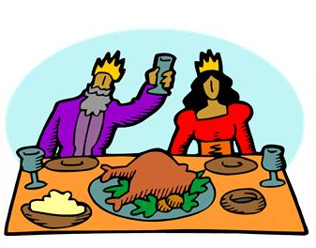
B. Theology of the Ministry
Abraham and Sarah
(circa 1800 BCE)
  Three visiting angels –who knew?
  Welcome seems particularly pleasing to God →Moves covenant forward to promise of Isaac’s birth.
  Hence: “You never know when you may be entertaining angels.”
Ps 23: 5-6
The Lord models hospitality
You prepare a table before me
in the presence of my enemies;
you anoint my head with oil;
my cup overflows.
Surely goodness and mercy shall follow me
all the days of my life,
and I shall dwell in the house of the Lord
my whole life long.
→safety, security, food, honor and distinction, forgiveness, goodness and a home with the Lord!
Notes:
As stated in the introduction, hospitality was a value in Middle Eastern society as far back as the time of Abraham and Sarah (circa 1800 BCE). The three visiting angels bless Abraham and Sarah for their hospitality by promising them a son within the year. Granted, they had been promised descendants as numerous as the stars and the grains of sand already, but this generosity moves their covenant with God forward to the definitive promise of Isaac’s birth. Abraham and Sarah did not initially know who the three visitors were; the fact that they welcomed anyone seems particularly pleasing to God. Hence the encouragement one sometimes hears: “You never know when you may be entertaining angels.”
In Psalm 23, the Lord models hospitality in a way that gives great comfort to the singer:
You prepare a table before me
in the presence of my enemies;
you anoint my head with oil;
my cup overflows.
Surely goodness and mercy shall follow me
all the days of my life,
and I shall dwell in the house of the Lord
my whole life long. (verses 5-6)
The singer finds safety, security, food, honor and distinction, forgiveness, goodness and a home with the Lord. Who has not read this and thought, “Oh, I would love to have that!”

Slide 15
New Testament
Mt 25:34-40
Then the king will say to those at his right hand, “Come, you that are blessed by my Father, inherit the kingdom prepared for you from the foundation of the world; for … I was a stranger & you welcomed me… “
Then the righteous will answer him, “Lord, when was it … that we saw you a stranger & welcomed you?”
And the king will answer them, “Truly I tell you, just as you did it to one of the least of these who are members of my family, you did it to me.”
Notes:
In the New Testament, Jesus’ entire ministry exemplifies the virtues of hospitality. He understands at a deep level how to love people and make them feel at home. Perhaps the clearest statement of God’s expectation of our being hospitable is to be found in the Parable of the Last Judgment (Mt 25:31-46). The only criteria for entering heaven are feeding the hungry, giving drink to the thirsty, welcoming the stranger, clothing the naked, comforting the sick and visiting the imprisoned. Jesus wonderfully shows what welcoming the stranger looks like in many other encounters throughout the gospels. Please use the worksheets in Appendix A to explore other stories where Jesus demonstrates aspects of hospitality.

Slide 16
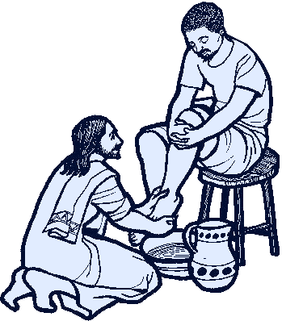
Being Christ for Others: NT
“So if I, your Lord and Teacher, have washed your feet, you also ought to wash one another’s feet. For I have set you an example, that you also should do as I have done to you.”
-Jn 13: 14-15
Notes:
In the final story on the worksheet, “Jesus Washes the Feet of the Disciples,” he tells them, “So if I, your Lord and Teacher, have washed your feet, you also ought to wash one another’s feet. For I have set you an example, that you also should do as I have done to you.” (Jn 13: 14-15) We have an obligation as Jesus’ disciples to show the same virtues of hospitality to everyone we meet.

Slide 17


Being Christ for others: Church history
The Breastplate of St. Patrick (5th century CE): unity & humility of our relationship with Jesus
St. Teresa of Avila (1515–1582): necessity & urgency:
  Christ has no body but yours,
  No hands, no feet on earth but yours,
  Yours are the eyes with which he looks
  Compassion on this world,
  Yours are the feet with which he walks to do good,
  Yours are the hands,
  with which he blesses all the world.
  Yours are the hands, yours are the feet,
  Yours are the eyes, you are his body.
  Christ has no body now but yours.
Notes:
This idea of being Christ for others is echoed in the writings of the saints. The Breastplate of St. Patrick (5th century CE) prays that everyone who sees, thinks or speaks of the person praying sees, thinks or speaks of Christ. We decrease as Jesus’ increases in us (cf John the Baptist in John 3:30). While St Patrick emphasizes the unity and humility of our relationship with Jesus, St. Teresa of Avila (1515–1582) emphasizes the necessity and urgency:
Christ has no body but yours,
No hands, no feet on earth but yours,
Yours are the eyes with which he looks
Compassion on this world,
Yours are the feet with which he walks to do good,
Yours are the hands, with which he blesses all the world.
Yours are the hands, yours are the feet,
Yours are the eyes, you are his body.
Christ has no body now but yours.
If we wish to be disciples of Jesus, we must love and serve as he did. We must emulate him in every way.

Slide 18
Seeing Christ in Others
”Very truly, I tell you, whoever receives one whom I send receives me; and whoever receives me receives him who sent me.”
(Jn 13:20)
“Truly I tell you, just as you did it to one of the least of these who are members of my family, you did it to me.” (Mt 25:40)
Rule of St. Benedict: “All guests who present themselves are to be welcomed as Christ.”
A discipline! Prayer → gradual changing of the heart
Notes:
The other spiritual pillar that undergirds Christian hospitality is our call to see Christ in others. After washing the disciples feet at the Last Supper, Jesus tells them, ”Very truly, I tell you, whoever receives one whom I send receives me; and whoever receives me receives him who sent me.” (Jn 13:20) The Son of Man, in the Parable of the Last Judgment, states, “Truly I tell you, just as you did it to one of the least of these who are members of my family, you did it to me.” (Mt 25:40)
This beautiful spiritual discipline of seeing Christ in others provides the basis for hospitality in monasteries that follow the Rule of St. Benedict. It states, “All guests who present themselves are to be welcomed as Christ.” Seeing Christ in others is indeed a discipline, especially with strangers and foes, but our prayerful requests for divine help at the start of the day and prayerful examination on how well we did at the end of the day can facilitate the gradual changing of the heart.

Slide 19

Mercy
Recognize our own need for God’s love and forgiveness.
Same need in others & be conduits of mercy
EVERYONE who comes is in need of God’s love.
  “A church is a hospital for sinners, not a museum for saints.” (Pauline Phillips, aka “Dear Abby”)
  “The Church is always in need of reform.”
Mercy helps us to accept all we meet.
Notes:
A further element of being hospitable is developing an attitude of mercy. We need to recognize our own need for God’s love and forgiveness. Then we can focus on that same need in others and gladly work on God’s behalf to be conduits of love and forgiveness. EVERYONE who comes is in need of God’s love. “A church is a hospital for sinners, not a museum for saints.” (Pauline Phillips, aka “Dear Abby”) This has been part of the Church’s wisdom through the ages: we have the Late Medieval maxim, which resurfaced at the Second Vatican Council, “The Church is always in need of reform.” Fostering in our hearts an attitude of mercy can in turn help us to accept all we meet.

Slide 20

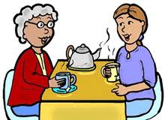
“For where two or three are gathered in my name, I am there among them.” (Mt 18:20)
“We greet Christ in one another long before we receive him in the sacrament of Communion.” (p. 7)
“[Ministers of hospitality] are hosts who put a face onto the parish. They welcome those who arrive and begin the process of forming them as a worshipping body.” (p. 5)
Guide for Ushers and Greeters, Karie Ferrell and Paul Turner
Notes:
In their helpful little book, Guide for Ushers and Greeters, Karie Ferrell and Paul Turner remind us of yet another gospel passage: “For where two or three are gathered in my name, I am there among them.” (Mt 18:20) Ferrell and Turner encourage the minister of hospitality to recognize that the quality with which we meet others can be the opening into which Christ can step: “We greet Christ in one another long before we receive him in the sacrament of Communion.” (p. 7) They also write, “[Ministers of hospitality] are hosts who put a face onto the parish. They welcome those who arrive and begin the process of forming them as a worshipping body.” (p. 5)

Slide 21
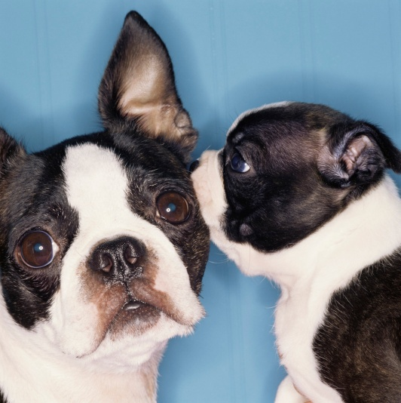
Evangelization & Hospitality
Your encounter is NOT the first step in their encounter with Christ.
Loving in a concrete way when “the lost” arrive
Seeking the lost sheep by “waking them up”
What got them to come to begin with?
Who me?
Notes:
Each person has a relationship with God who made him/her. Everyone’s life is a process of deepening that relationship, made easier or harder in part by the encounters each of us has with other human beings along the way. We can each play a part but we must keep in mind that our encounter with a given person is NOT the first step in their encounter with God. There is “something bigger” happening and our encounter with a person is one scene in that larger play unfolding. So, ministers of hospitality can see themselves as having a role to play in God’s work of evangelization. Practically speaking, they can welcome with love newcomers who visit the parish and they can awaken the “regulars” to the place of love and mercy at which they have arrived. This is done concretely by removing concerns, creating a sense of belonging and let people know, “This is a place where I can be loved.”

Slide 22
C. History of the ministry:
St. Joseph Parish in Keyport, NJ
Oldest lay ministry in the Catholic Church
Ushers in the Bible
“Keepers of the threshold” collected money offerings from the people (2 Kings 22:4)
Also 1Chronicles 9:19
Jeremiah 35:4 –Shallum = keeper of the threshold
1Chronicles 26 -classes of gatekeepers kept watch 24/7
Nehemiah 7:45 -138 gatekeepers returned to Jerusalem after the Babylonian exile
Later, included as members of Levites who ministered at the Temple
Notes:
The ministry of ushers is the oldest lay ministry in the Catholic Church. The ushers of today have descended from a long line of people of God who have gone before them.
Ushers in the Bible
The Second Book of Kings speaks of the “keepers of the threshold” who collected money offerings from the people (2 Kings 22:4). Guardians of the threshold are also mentioned in 1Chronicles 9:19, and Jeremiah 35:4 calls Shallum a keeper of the threshold. 1Chronicles 26 lists several classes of gatekeepers who kept watch twenty-four hours a day. Nehemiah 7:45 notes that 138 gatekeepers returned to Jerusalem after the Babylonian exile. After that time, they seem to have been included as members of the Levites who ministered at the Temple.

Slide 23

Ushers in Christian History
During time of Christ, hundreds of doorkeepers of temple
Clerical order of porter:
  Pope Cornelius (3rd-cent.) - doorkeepers serving
  Church of Rome.
  Apostolic Constitution, (4th-cent. Syrian Church)
  -includes role of doorkeeper or porter.
  Duty: guard door against intruders who might
  disturb service
Middle Ages: porter = one of 4 minor orders (carrying out some original functions of deacons)
  Thomas Aquinas - porter duties ="to ring the bells, open the church and sacristy, to open the book for the preacher."
  The minor order of porter was conferred on all those seeking ordination to the priesthood
Pope Paul VI suppressed minor orders (1972) →task goes to laity
VCII’s renewal of liturgy - foster community's full participation in liturgy from time one enters church to worship
Notes:
Ushers in Christian History
During the time of Christ, the doorkeepers of the temple numbered in the hundreds and were the forerunners of today's ushers. The more immediate predecessor of today's usher can be found in the clerical order of porter. The third-century letter of Pope Cornelius mentions doorkeepers serving the Church of Rome. The Apostolic Constitution, a fourth-century Syrian Church document, also speaks of the role of doorkeeper or porter. During those times, it was the duty of the porters or ushers to guard the door of the church against any intruders who might disturb the service.
In the medieval period, the role of porter was one of the four minor orders, which Thomas Aquinas described as carrying out some the original functions of deacons in the church. The porter duties were specified as "to ring the bells, open the church and sacristy, to open the book for the preacher." The minor order of porter was conferred on all those seeking ordination to the priesthood until Pope Paul VI suppressed all the minor orders in 1972 and this important task was given over to the laity.
Laymen who served as ushers generally carried out the actual ministry in their parishes. For generations, ushers have assisted parish worship by welcoming people, helping them find seats in church, taking up the collection and passing out parish bulletins. In the renewal of the liturgy from the Second Vatican Council, this ministry has undergone a further transformation. Now the ministers are called to perform tasks intended to foster the community's full participation in the liturgy from the time one enters the house of God to worship.

Slide 24
VII. Requirements of ministry:
Many Options!
Greeters
Ushers
Parking Team
Information
Accessibility and Campus’ Ease of Use
Fellowship
Bakers
Ministry Brochure/ Fair
New parishioners
Sacramental Prep
Childcare
Greeters & Ushers:
Same or Different?
Notes:
VII. Requirements of the Ministry
There are many components of the ministry of hospitality, although most people think about them only in terms of ushers and greeters. Here is a list:
Greeters
Ushers
Parking
Information
Accessibility and Campus’ Ease of Use
Fellowship
Bakers
New Parishioners
Sacramental Prep
Ministries Brochure/FAir
Childcare
The roles of greeter and usher are different from parish to parish, where they may be separate ministries or one combined ministry. How a parish defines them is determined by the history and culture, as well as the understanding of liturgy of the parish. If they are separate ministries, what follows is a general description of what they might include.

Slide 25
Greeters, page 1
Greet EVERYONE
What to say:
  Welcome!
  So glad you have come!
  Thank you for coming!
  How are you today?
  I like your hair/coat/
  dress/shoes/tie!
  Isn’t the weather great/freezing?
  Is everyone awake yet?
Purpose: create atmosphere of welcome
  Begin to build a relationship w/ newcomers
  Develop relationships w/ parishioners
Nametags build relationships!
  represents parish community
  lets newcomer see greeter’s name
Arrive 15-20 minutes early & stand at the doors
  Outside the door and open it?
Notes:
The roles of greeter and usher are different from parish to parish, where they may be separate ministries or one combined ministry. How a parish defines them is determined by the history and culture, as well as the understanding of liturgy of the parish. If they are separate ministries, here is a general description of what they include:
Greeters
Greeters are responsible for creating an atmosphere of welcome. They begin to build a relationship with each newcomer and they develop relationships with parishioners. Relationship building starts with a nametag, which
a) allows the person arriving at the church to know that this person is a representative of the parish community and
b) begins the relationship by letting the newcomer see the greeter’s name. (Most people are visual learners so seeing the name is more helpful than just hearing it said.)
Greeters should arrive 15-20 minutes before the mass begins and stand at the doors. If the weather is not inclement, they can stand outside the door and open it for people while greeting them. It is essential that they greet EVERYONE, not just their friends. They can say one of the following or something equally friendly:
Welcome!
So glad you have come!
Thank you for coming!
How are you today?
I like your hair/coat/dress/shoes/tie!
Isn’t the weather great/freezing?
Is everyone awake yet?

Slide 26
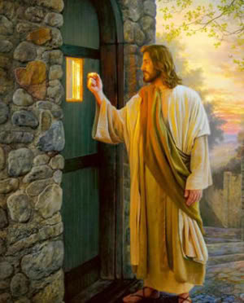
Greeters, page 2
Help visitor find a seat → briefly explain missal
  Sit w/ non-Catholic visitor to guide?
A smiling face
  Non-verbal expression
  Welcome & love expressed culturally by being happy to see person
Source of information about building & parish
During mass, be friendly to those seated nearby
MAYBE: say good-bye as people leave & hand out bulletins
  Reinforce the love of God & concern of community
  Smile & “Have a great week!” or “Looking forward to seeing you next Sunday!”
  →Positive impression: “This is a place where I belong.”
Notes:
If someone is a visitor, the greeter should help them find a seat. The greeter can also briefly explain the missal/songbooks the parish uses. It may be helpful to ask if they are Catholic; if they are not, the missal is essential to following along with the complex ritual of the mass. The greeter may sit with the non-Catholic visitor during the liturgy to help guide them.
A smiling face is absolutely essential to this ministry! The majority of communication takes place through non-verbal expression, so a greeter must make sure that his/her face and body are saying what his/her mouth is saying. Welcome and love are expressed in our culture in large part by looking happy to see the person and that definitely includes smiling at them.
The greeter is a source of information about the building and the parish. The greeter should be familiar with the parish campus –exits, bathrooms, handicap accessibility, the location of the shrine or Eucharistic adoration chapel, for example—and the parish itself –how to register for the parish or for religious education, parish office hours, when the Bible study meets, who to contact about joining the men’s club, for example. Studying the bulletin can help with this; it is also important to know the parish staff.
The greeter does not have any responsibilities during the mass but should continue to be friendly to those seated nearby.
If it is the purview of the greeters, after the Prayer after Communion, they should go back to the doors of the church to say good-bye as people leave and to hand out bulletins. Like the greeting before mass, this is an opportunity to reinforce the love of God and the concern of the community for each person who has attended. A smile and a “Have a great week!” or “Looking forward to seeing you next Sunday!” gives the person a positive final impression that, “This is a place where I belong.”

Slide 27
Ushers, page 1
Arrive 20-25 mins early to tidy up pews & entrances
Assist w/seating, esp. at crowded liturgies or after mass starts
  Families w/ small children
  Persons in wheelchairs or with walkers or canes → need communion in pew?
  Those w/ difficulty hearing
Source of information about building & parish
Purpose: help liturgy flow
  Direct seating & movements outside pews
  Take up collection
Need to be kind, pleasant & Christ-like
  Speak politely & treat w/ welcome & respect
  Each person is a child of God & worthy of love.
Name tags important
  Official representative of parish
  Begin relationship by easy sharing of the usher’s name
Notes:
Ushers
The ministry of usher is primarily to help the liturgy flow smoothly. Ushers direct the congregation’s seating and movements outside their pews and take up the collection. While the ministry of usher may seem to be less personable and more about logistics or crowd control, it is nevertheless a ministry of hospitality and requires that ushers be kind, pleasant and Christ-like. Ushers will find that the old adage, “You can catch more flies with honey than with vinegar,” is quite true: people will cooperate more if they are spoken to politely and treated with welcome and respect. This is done, not out of a sense of manipulation, but rather because each person is a child of God and worthy of love.
As for greeters, name tags are an important starting point. Name tags establish that the usher is an official representative of the parish; they also allow a relationship to begin by the easy sharing of the usher’s name.
The ushers should arrive 20-25 minutes before the liturgy begins, so they can tidy up the pews and entrances if needed. This may include straightening out the door mats, removing extra bulletins and trash from pews and/or replacing missals or hymnals.
Ushers assist with seating, especially at crowded liturgies or after the mass has begun. Ushers can help families with small children decide on seating that is best for them. Ushers should know where the seating is for persons in wheelchairs or with walkers or canes. The ushers should check if these people will need communion brought to them in the pew or if they can come up to the sanctuary and then convey that information to the Eucharistic ministers. The ushers should also know where the sound is best for those with difficulty hearing and/or where to sit if the parish has a sign language interpreter.
Like the greeter, the usher is a source of information about the building and the parish. The usher should be familiar with the parish campus –exits, bathrooms, handicap accessibility, the location of the shrine or Eucharistic adoration chapel, for example—and the parish itself –how to register for the parish or for religious education, parish office hours, when the Bible study meets, who to contact about joining the men’s club, for example. Studying the bulletin can help with this; it is also important to know the parish staff.

Slide 28
Ushers, page 2
MAYBE invite someone to take up gifts
  Give clear directions
  Be there to assist during liturgy
Help latecomers find a seat
Know how to handle overflow crowds
Balance being a full participant in liturgy & assisting others
  Preparing readings ahead of time
  Praying before coming to church
After Universal Prayer, take up collection
Guide parishioners to communion
MAYBE say good-bye as people leave and to hand out bulletins
  Reinforce love of God & concern of community
  A smile & “Have a great week!” or “Looking forward to seeing you next Sunday!”
  → Positive final impression: “This is a place where I belong.”
Notes:
In some parishes, before mass begins, it is the job of the ushers to invite someone in the congregation to take up the gifts of bread and wine. The usher should give clear directions about when this occurs and be available to assist the gift bearers during the liturgy.
As mass begins, the usher should be aware of open seats, so they can help latecomers easily and discreetly find a seat. Ushers should also know how to handle overflow crowds.
During the liturgy, the usher must strike a balance between being a full participant in the liturgy and assisting others. Because the usher is a representative of the parish, it is important that he/she model prayerful participation. So, it is a good idea for the usher to stand in the back of the church where he/she can direct people to the restrooms or spot medical situations and offer aid. However, the usher should still be attentive to the liturgy, sit, stand and kneel at the appropriate times, and pray and sing. The usher should look at where the action of the liturgy is taking place –the lector, the altar, etc.—and not talk unnecessarily with other ushers or congregants. Preparing the readings ahead of time will allow the usher to easily return to listening to them during the Liturgy of the Word or refocusing on the homily, should someone need something at that time. Praying before coming to church for the Holy Spirit to act through the usher at all times and to make all his/her ministry a loving act of prayer places all the “activities” of ushering in a context of prayer; this may help the usher move between praying the liturgy and ministering as an usher.
After the Universal Prayer, the ushers take up the collection. The process varies from parish to parish, so the usher should ask a parish staff member how it should be done. Many people may feel awkward or embarrassed about the collection. The ushers can smooth things out by once again finding a balancing point for their behavior:
smiling and making eye contact but not staring;
giving people enough time to get their money out but not waiting too long as if to say, “Where is it?”; and
keeping things moving, but not being conspicuous, pushy or jostling people.
If a parishioner is taking too long, the usher should offer to come back or tell him/her where to put the check after mass. If the parish uses baskets, the usher should be alert to parishioners who get confused and move the basket to the next pew.
As the priest, deacon and Eucharistic ministers are receiving the bread and wine, the usher should come to the front of the area he/she is to guide to communion. As the ministers move into place, the usher should invite the people in the first pew to come to the station to receive. The usher steps back to let one pew of people out at a time. The courteous host always eats only after the guests have been served; so likewise with the ushers, who should receive when everyone else has done so.
If it is the purview of the ushers, after the Prayer after Communion, they should go back to the doors of the church to say good-bye as people leave and to hand out bulletins. Like the greeting before mass, this is an opportunity to reinforce the love of God and the concern of the community for each person who has attended. A smile and a “Have a great week!” or “Looking forward to seeing you next Sunday!” gives the person a positive final impression that, “This is a place where I belong.”

Slide 29

Other Ministries of Hospitality
Parking:
Team directs traffic
Helps people find spots
Indicates handicap parking
Knows street parking rules
Especially useful at masses with large crowds
→Clarity keeps potentially sinful
area flowing
smoothly
Information: table where people
Join parish
Get mass cards, sponsor cards, etc.
Any info they would have had to come to office for
Notes:
Other Ministries of Hospitality
Some parishes have broadened their vision of the ministry of hospitality. Here are a number of other ministries that a parish might have to welcome newcomers and parishioners.
Parking Team
The need for a parking team ministry is dependent on the size and location of the parish. A large, urban parish will more likely need this than a small or rural parish with ample parking. However, this ministry can be particularly useful any time there is a larger-than-usual crowd expected, like Christmas, Easter or First Communion.
Parking can be stressful in several ways. It can be hard to find a spot, especially for a family with children who is running late or for an elderly driver, who may have special concerns or be easily confused. A newcomer will have no idea what the parking arrangements and traffic flow are. People who are eager to leave in a hurry can create an occasion of sin for themselves and others.
The parking team relieves these tensions by directing traffic in a courteous and friendly way. As a result, parishioners and newcomers can enter and leave the church campus in a much more spiritual, relaxed and Christian frame of mind. Patience, smiling, saying “please” and “thank you” as well as “hello” and “good-bye” are small but significant ways to bring the love of God to others and to keep the wheels of progress well oiled.
Members of the parking team arrive 25-30 minutes before mass begins. They help people find spots to park and keep the flow of traffic moving smoothly. They indicate handicap parking and assist those with physical disabilities to get in and out of their cars as needed. They know the local laws for street parking and share that information as needed.
Members of the parking ministry team should also be present at the end of mass to keep the flow of departing cars moving smoothly.
Information Team at Weekend Masses
One way to welcome people is to meet them where they are at, to make getting what they need as easy as possible. Asking people to come to the parish office during the week can be burdensome. Since most parishioners come to the parish only on weekends at mass time, a parish can set up an information table where parishioners can get a mass card, get a sponsor card, register, or find out most information they would have to come to the office for.
People who minister on the Information Team should be at a separate and clearly marked table in the gathering space. They should be friendly people who are organized and good at explaining information clearly and concisely. They should arrive 15-20 minutes before mass and be at the table again as the closing procession is happening. Smiling and giving information in a cooperative, respectful manner shows the person that he/she is a valued member of the community.

Slide 30

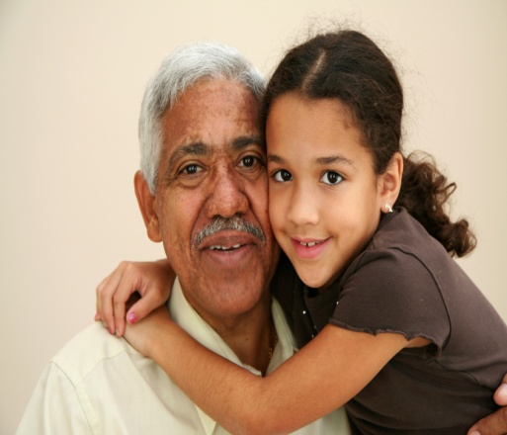
Accessibility & Campus’
Ease of Use
Clearly marked buildings? Would a stranger know which building is which? Would they know where a certain meeting room is?
How accessible are your buildings
for the elderly? For the handicapped?
Places for families with small children
Campus Tour: even pavement, adequate night lighting, safe, pleasant
Seating for handicapped & elderly? Do EM’s bring the Eucharist to them?
Notes:
Buildings and Grounds Subcommittee for Accessibility and Campus’ Ease of Use
The accessibility of a parish campus makes a clear statement of welcome to newcomers and persons with special needs. Conversely, if a person cannot get into the church or church hall, he/she cannot attend the liturgies or church events.
Many parishes have a Buildings and Grounds Committee, official or unofficial. This group or a subcommittee can tour the campus with an eye to how the campus looks to visitors and how easily the elderly and disabled can maneuver it. Here are some things to look for:
Are the buildings clearly marked? Would a stranger know which building is which? Would they know where a certain meeting room is?
How accessible are the buildings for the elderly? For the handicapped? (Enter each building with an elderly person and a person with a walker. Where do they struggle?)
Is there at least one bathroom stall that is wide enough for a wheelchair to enter? Are there grab bars?
Are there places for families with small children?
Check for uneven pavement, adequate night lighting, safety, pleasantness, cleanliness.
Obviously, the next step is to address any problem areas. Take this tour at least every other year, since signs fade and pavement shifts.

Slide 31
Fellowship & Bakers
Fellowship
Develop & lengthen people’s time/relationship →food/drink & visiting time after mass:
  Coffee & donuts
  Café
Room to mingle
NOT out of the way
Religious ed. parents while they wait
Bakers –team to provide “coffee &…”after special masses or at special parish meetings
Notes:
Fellowship Committee
To move newcomers and parishioners beyond “acquaintances” to “friends” takes time. A parish can provide the time and subsequent opportunity to develop relationships by offering food/drink and visiting time after liturgies. If a parish does not have enough time between masses to accommodate people staying for fellowship, perhaps it could consider lengthening the time between liturgies.
Americans see themselves as busy. Asking them to walk to another building for fellowship usually does not work. This ministry should be located in the gathering space or no further away than the church basement.
Some parishes keep this simple with coffee/juice and donuts. Some have designed a café in a separate room with tables, light supper fare after Saturday liturgies and light breakfast fare on Sunday mornings.
The members of the fellowship committee need to arrive with enough time before mass to prepare the food/drink as much as they can in advance. If more elaborate food/drink is being offered, they may need to attend one mass and minister at another. Fellowship ministers present the food and drink in attractive ways and tidy up the area as people serve themselves. Ministers should be helpful, cheerful and welcoming.
Bakers
Jesus knew that a lot can happen if and while people are fed. They are taken care of physically and so can become aware of spiritual and emotional needs. Conversations can happen. Furthermore, food can be a way that the provider of the food shows love. A parish can likewise communicate hospitality and love by serving food regularly to those who come to parish events.
A parish team of bakers can provide home-baked goodies for special masses or at large/special parish gatherings (for example at the reception after the Easter Vigil.) Serving can be done by the bakers or by others. A notice can go in the bulletin and parish webpage for bakers. This ministry needs a coordinator, who is the contact person for requesting baked goods and who calls the bakers and organizes the baking.

Slide 32
Ministries Brochure
Ministry Fair
→ Each member of the Body of Christ brings unique gifts
Belonging & Invitation
Ministry fair:
1-2x/year after masses
In church hall
Tables for each ministry to display info
Reps to welcome, inform & sign up new participants
Freebies, drawings & flyers
Organizing committee invites all ministries to participate
Brochure:
Committee members comfortable w/computer
Pastor’s letter of welcome
Contact information for the parish office and staff
List of all programs and ministries offered by parish w/description, name of person in charge & contact info
Notes:
Ministries Brochure/Booklet and/or Ministry Fair
Many people feel they truly belong to a parish when they begin to participate in its ministries. A ministry brochure or ministry fair functions to let people know what their options are AND to invite them to join. It is important to acknowledge that each member of the Body of Christ has a unique gift to bring to the life of the parish.
A small committee whose members are comfortable using a computer program like Microsoft Word or Publisher could assemble the brochure. It is common to include a letter of welcome from the pastor and contact information for the parish office and staff. The committee compiles a list of all the programs and ministries offered by the parish as well as a brief description of each, the name of the person in charge and contact information, usually a phone number and email address. The bulletin and parish web page are good resources as are the parish secretary and pastor.
Some parishes choose to hold a ministry fair once or twice a year after all the masses, often on Pentecost or the parish feast or at the beginning of the school year. The fair should be held in the church hall or building nearby on the same campus. A representative from each ministry and committee is given a table on which to display information about the program or ministry. A representative is there to welcome, talk about the ministry or program and to sign up new participants. Freebies, drawings and, of course, flyers for each program/ministry are helpful. An organizing committee for this fair would reach out to all the program/ministry chair persons to invite their participation and see if they will need anything special for their table (like an electrical outlet for a laptop.)

Slide 33
New parishioners
Folder with all parish info that would be helpful
  Census
  Ministry booklets
  Programs interesting to newcomers
    x Parochial school x Religious ed
  Electronic giving
  Parish mission statement and 3-5 yr plan
  DO NOT fundraise
Visit/Call
Supper
  Multiple times/year
  W/ parish staff and/or parishioners who sit with newcomers
  Share parish plan/programs & invite participation
Personally invite to parish events the first year
Notes:
Welcome Committee for New Parishioners
The parish office staff will need to notify the welcoming committee of new parishioners at regular intervals.
There are several ways that a parish can welcome new parishioners. The first is to assemble a folder with helpful parish information such as:
Parish web address, email address, contact information
A census form or directions for it on the parish website
Ministry brochure
Information on the parochial school
Information on religious education
Flyers for programs that match the newcomers
Information on electronic giving
Parish mission/vision statements, core values and 3-5 year plan
Members of the welcoming committee can assemble the folders and keep the information up to date.
These folders can be delivered by mail, but are more effective at welcoming if they are accompanied by a phone call or a home visit. Members of the welcoming committee can take turns with phone calls and home visits. It is important to be sure that the call or home visit is at a time convenient for the new parishioners. Ministers should be friendly, interested in learning about the new parishioners and able to identify and share information pertinent to the newcomers. (For example, no need to tell all about the elementary religious education program to a family with high school aged children.)
These folders can also be delivered at a parish supper, offered multiple times/year depending on the number of new parishioners. Welcoming committee members would call the new parishioners personally to invite them and find out if they are actually able/willing to attend. A simple meal can be prepared by the welcoming committee members or others (or catered out). At the supper, parish staff and/or parishioners sit with the newcomers --not each other! After the meal the pastor, parish staff, welcoming team members and/or members of the parish pastoral council can speak to the whole gathering about the parish’s 3-5 year pastoral plan and/or programs the parish offers. Importantly, they can invite the newcomers to participate. Just as importantly, they absolutely should NOT fundraise, as this is inappropriate and unwelcoming.
Finally, the welcoming committee can personally invite new parishioners to parish events the first year of their membership via a phone call.

Slide 34

Sacramental Prep
Attitude of welcome
Meet people where they are
Baby-sitting service
Feed so evening meals are not an issue
Childcare
Provide for all events where you expect adults to attend
Notes:
Ministry of Hospitality for Sacramental Prep
For better or for worse, many people come to church primarily for sacraments. This means that this is a golden opportunity for evangelization, that is, for helping them to know Christ’s love and how being part of the Catholic Christian community can feed them. Approaching sacramental preparation with an attitude of welcome is foundational. Those ministering in sacramental preparation must be glad that the families have come and make events comfortable. Practically, this looks like offering baby-sitting service during parent meetings and offering a meal (or at least a potluck) during evening meetings so getting everyone fed at home before the meeting is not an issue. Theologically and spiritually, ministers must meet people where they are, not where they would like them to be. By the same token, ministers must also challenge the people coming for sacraments to grow beyond where they are now, as Jesus did with the Samaritan Woman (John 4:4-30).
Childcare Ministry
Again, to meet people where they are at, a parish must recognize and work with the real circumstances of parishioners’ lives. If parishes wish to have adults attend events, they must be aware that many adults have school aged children who cannot be left alone. A childcare ministry can provide childcare for events adults are expected to attend. A clean room with a variety of clean toys, competent adults who are comfortable with children, some organized activities, like games or an art project, and a snack of juice and pretzels/cereal are needed.

Slide 35
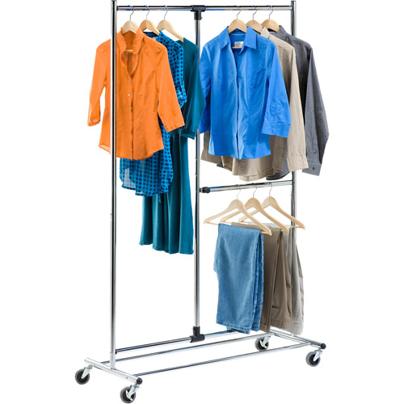
IX. Serving in this Ministry
Attire
Clothing makes a statement.
  Formal or informal?
  Uniform or individual?
Clean, without rips and modest → no one is offended
Making 1st impression for parish
Ask pastoral staff what message they would like you to send.
Notes:
IX. Serving in this Ministry
A. Attire: Clothing makes a statement. It can be formal or informal. It can be uniform –think matching suit coats or matching polo shirts –or individual. No matter what, it should be clean, without rips and modest, so that no one’s sensibilities are offended as the hospitality minister makes a first impression on behalf of the parish. Ministers should find out from pastoral staff what message they would like to send, i.e. how to dress.

Slide 36
B. troubleshooting:
Emergencies
Know what to do in case of an emergency.
Parish plan for emergencies, incl. weather
How to reunite children in religious ed w/ families
Emergency exits, fire extinguishers, defibrillators & first aid kits?
Take a first aid course
Parish plan to deal with violence
Silenced cell phone →911
Disruptions
Be compassionate: bring Christ to situation and people
Children = part of the Body of Christ and welcome even if noisy. If adult brings noisy child to back of church:
  kind word,
  offer of help
  directions to cry room or nearby space, if needed
Adult: gently, firmly lead to place where you can talk
  Need another minister for safety
Notes:
B. Accidents or problems (troubleshooting):
Emergencies: Ministers of hospitality should know what to do in case of an emergency. They should learn and follow the parish plan for handling emergencies, including for weather emergencies common in the geographical area. They should know how to reunite children in religious education with their families if needed. They should know the emergency exits and locations of the fire extinguishers, defibrillators and first aid kits. Ministers of hospitality may wish to take a first aid course so that they will be better prepared to help as needed. They should know the parish plan to deal with violence. They should keep a silenced cell phone with them to call 911 if needed.
Disruptions: When disruptions occur –and they will!— ministers of hospitality should be compassionate. It is important to remember that they are bringing Christ to the situation and to the persons involved. Children are part of the Body of Christ and welcome even if noisy. If an adult brings a noisy child to the back of the church, the minister of hospitality can assist with a kind word, an offer of help and directions to a cry room or nearby space, if needed. If an adult is disruptive, the minister of hospitality should gently but firmly try to lead him/her to a place where they can talk. The minister should be sure to have another minister go with him/her for safety.

Slide 37



C. Practicum
Persuading people to move into a pew from the aisle seat or to sit in the front rows
Running out of seats at a special liturgy, like Christmas or Easter
Being told the bathrooms are out of paper towels or toilet paper
Handling a medical emergency
A homeless person asks you or other parishioners for help.
The fire alarm goes off.
An animal enters the church.
Notes:
C. Practicum: You may wish to role play scenarios where participants get to act out how they would welcome people and/or troubleshoot problems. Some potentially troublesome situations include:
Persuading people to move into a pew from the aisle seat or to sit in the front rows
Running out of seats at a special liturgy, like Christmas or Easter
Being told the bathrooms are out of paper towels or toilet paper
Handling a medical emergency
A homeless person asks you or other parishioners for help.
The fire alarm goes off.
An animal enters the church.

Slide 38
X. Questions
XI. RESOURCES: Annotated Bibliography
Notes:
X. Questions: Take questions from the group
XI. Resources: See manual for annotated bibliography of books/pamphlets on various aspects of hospitality ministry.

Slide 39
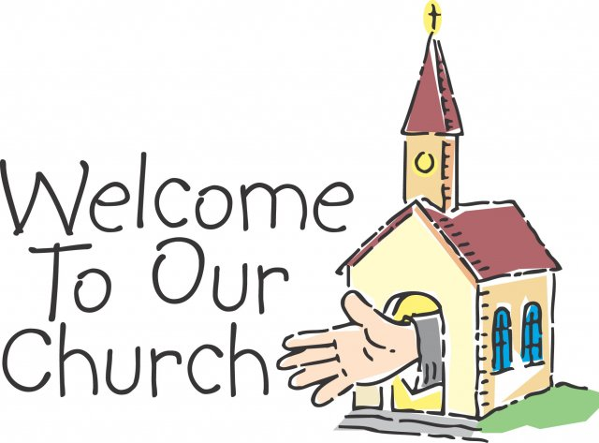
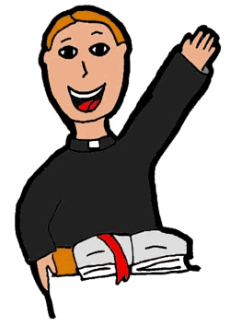

XII. Ongoing Formation
A. The Parish’s Role
Create a context for hospitality:
  Most parishioners do not know that they should be welcoming.
  Part of discipleship
How to?
  Homilies
  Info Series: in bulletin and/or brief talks before mass or after communion
    E.g. “Hospitality Is Biblical –It’s Not Optional”
Reflection questions to talk about in pew (or to take home)
Notes:
XII. Passages on the experience/spirituality of the ministry – for use now or for ongoing formation
A. To form the parish’s understanding of its role in hospitality:
One reason a parish may not appear to be very welcoming is because most of the parishioners do not know that they should be. They are comfortable and resultantly do not consider how others are feeling. It is essential therefore to alert them to this responsibility, to let them reflect on it and to give them some information on what they can do.
Here are some methods a parish can employ. The first requires the buy-in of the pastor and any priests who preside at the parish liturgies, but it is perhaps one of the easiest and most effective ways to catechize the congregation, namely a series of homilies on the virtue of hospitality and our responsibility toward it. Three or four weeks in a row would provide enough repetition for people to realize that a message was being conveyed. Many gospel readings have hospitality themes or elements, particularly during Ordinary Time or in the Christmas season.
If the pastor is not willing to use the homily in this way, perhaps catechesis could take place through a series of articles/items in the bulletin and/or in a brief talk before mass or after communion.
Bulletin insert or link to article on parish webpage. E.g. “Hospitality Is Biblical –It’s Not Optional” at https://www.catholicculture.org/culture/library/view.cfm?recnum=6981
Give people an opportunity to reflect on the message in the homily series, the bulletin inserts or talks before mass/after communion, by asking the following reflection questions and allowing 3-5 minutes for answering. If you use the homily series or the series of talks, ask parishioners to turn to the person sitting closest to them and share their answers. Use 1-2 questions/week.
Look at our parish through the eyes of a visitor. What would your experience be like?
What are we doing now to welcome visitors?
Who sits around you regularly but you do not know? (If you can honestly say, “No one,” try sitting in a different part of the church)
Recall a time when you felt welcomes in a strange place. What did people do to make you feel that way? Are you and your fellow parishioners doing that now?
What is one thing you can do to help everyone feel at home in our parish?
If you imagine our parish as a model of hospitality, what 3 things would be key?

Slide 40

questions to prompt thinking:
What does our parish look like thru the eyes of a visitor?
What are we doing now to welcome visitors?
Do you know the names of those who sit by you?
Recall a time you felt welcomed in a strange place. What made you feel that way? Are you and your fellow parishioners doing that now?
What is one thing you can do to help everyone feel at home in our parish?
If you imagine our parish as a model of hospitality, what 3 things would be key?
Notes:
Give people an opportunity to reflect on the message in the homily series, the bulletin inserts or talks before mass/after communion, by asking the following reflection questions and allowing 3-5 minutes for answering. If you use the homily series or the series of talks, ask parishioners to turn to the person sitting closest to them and share their answers. Use 1-2 questions/week.
Look at our parish through the eyes of a visitor. What would your experience be like?
What are we doing now to welcome visitors?
Who sits around you regularly but you do not know? (If you can honestly say, “No one,” try sitting in a different part of the church)
Recall a time when you felt welcomed in a strange place. What did people do to make you feel that way? Are you and your fellow parishioners doing that now?
What is one thing you can do to help everyone feel at home in our parish?
If you imagine our parish as a model of hospitality, what 3 things would be key?

Slide 41

Ongoing Formation
B. Cultivating a hospitable heart
“After Mass and throughout the week, strive to cultivate a hospitable heart. Work on the demeanor you will bring with you to church. This works both ways. Your service at church will also help you keep a kindly spirit at home and at work throughout the next week.”
-Ferrell & Turner, p. 15
Notes:
B. Cultivating a hospitable heart
“After Mass and throughout the week, strive to cultivate a hospitable heart. Work on the demeanor you will bring with you to church. This works both ways. Your service at church will also help you keep a kindly spirit at home and at work throughout the next week.”
-Ferrell & Turner, p. 15

Slide 42
1. Be welcoming
Say hello to everyone.
Don’t force yourself on others.
Learn people’s names.
Learn from the way people welcome you.
Be a good guest.
Notes:
1. Be welcoming.
Say hello to everyone.
Don’t force yourself on others. Making the offer is a gift.
Learn people’s names.
Think about how people welcome you and learn from it.
Be a good guest.

Slide 43
Consider:
How did you react when the phone rang? Did you feel inconvenienced? Was it noticeable in your voice?
How do you handle tele-marketers? Did you hang up on them? Do you refuse to listen to them? Do you get angry? Do you politely turn them aside?
How do you respond to email or texts? Do you read the messages carefully? Are you prompt in responding? Do you ever respond with rage?
How do you respond when a stranger asks for help? Are you anxious to be of service or anxious to get away?
Do you judge by appearances?
  If the person asking for help has a different skin color than you do, a different accent than your friends use, or different clothes than you wear, do you find yourself getting tense?
  Do you avoid persons of a certain age – young or old?
  Are you more likely to help the handsome and the beautiful than the sick and disfigured?
Notes:
Consider the way you responded to others in the last few days:
How did you react when the phone rang? Did you feel inconvenienced? Was it noticeable in your voice?
How do you handle tele-marketers? Did you hang up on them? Do you refuse to listen to them? Do you get angry? Do you politely turn them aside?
How do you respond to email or texts? Do you read the messages carefully? Are you prompt in responding? Do you ever respond with rage?
How do you respond when a stranger asks for help? Are you anxious to be of service or anxious to get away?
Do you judge by appearances? If the person asking for help has a different skin color than you do, a different accent than your friends use, or different clothes than you wear, do you find yourself getting tense? Do you avoid persons of a certain age – young or old? Are you more likely to help the handsome and the beautiful than the sick and disfigured?

Slide 44
2. Discern needs
Be attentive to the needs of those who come to church.
Practice all week
Discuss:
  What are some needs you might spot at church?
  During the week?
Notes:
2. Discern needs.
Be attentive to the needs of those who come to church. Practice this skill all week long.
Discuss:
What are some needs you might spot at church?
During the week?

Slide 45

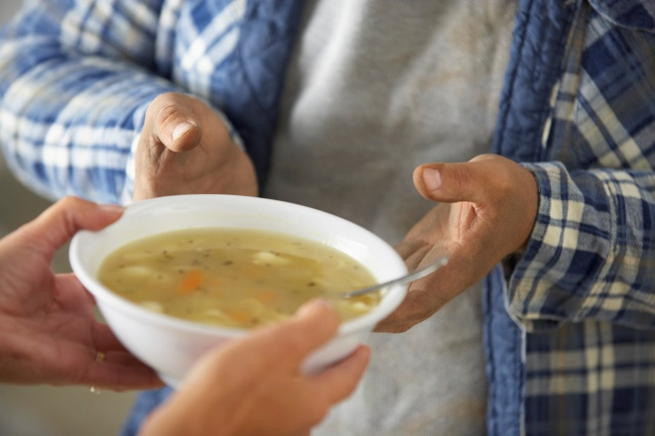
3. Be Prudent & Trustworthy
All we have is God’s, comes from God and needs to be returned to God →We are stewards.
Be generous with time, talent & treasure
  Appreciate sacrifices & gifts of others
  Your personality will change: think less of self/things & more of others
Notes:
3. Be prudent and trustworthy
All we have is God’s, comes from God and needs to be returned to God →We are stewards.
Be generous with all 3: time, talent and treasure
→You will appreciate the sacrifices and gifts of others
→Your personality will change: less clingy to things; think less of self and more of others

Slide 46

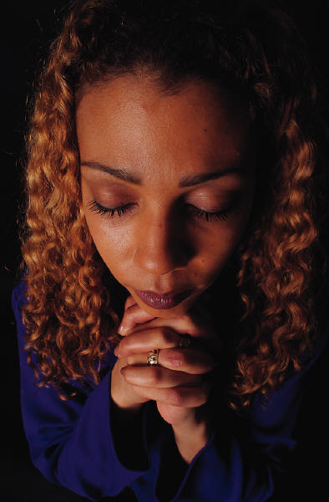
4. Be part
of the team
5. Be prayerful
All week: Your time w/ Jesus = important
  Jesus: a model pray-er
  We focus on God
At Mass: Martha or Mary? (Lk10:38-42)
  Role at mass = worship
  Prepare readings ahead of time
Discuss:
At home, who is responsible for the hospitality?
Do you let everyone have a role?
Notes:
4. Be part of the team.
There is a Messiah and it’s not you → others can connect, help, be part!
Discuss: At home, who is responsible for the hospitality? Do you let everyone have a role?
5. Be prayerful.
Throughout week: Your time with Jesus is important
Jesus is a model of prayer.
We are nothing without a prayer life to keep our focus on God.
At Mass:
Are you Martha or Mary? (Lk10:38-42): Recognize that Martha should be able to visit with her guests, esp. with Jesus.
Role at mass is to worship so participate and don’t just fuss over your ministry.
Prepare readings ahead of time.

Slide 47
Is Our Parish Welcoming?
My parish is easily identified w/ name & times of masses visible from road.
Church rectory & parking lot well marked & easily identified
Rooms & buildings clearly marked
Parish buildings wheel-chair accessible
Parking spaces for persons w/ disabilities
Large print missalettes & listening devices available
Hospitality ministers greet & assist people at all masses.
New parishioners are introduced to the community.
Our parish works toward inclusion for those who speak other languages.
Our parish welcomes young children, those w/ special needs & persons of all ethnic backgrounds.
The parish community reaches out in times of grief.
Hospitality: The Doorway to Evangelization
Notes:
C. How Hospitable Is Our Parish?
Evaluate your parish based on the following descriptors.
My parish is easily identified w/ parish name & times of masses visible from road.
The church, rectory & parking lot are well marked & easily identified.
Rooms & buildings are clearly marked.
Parish buildings are wheel-chair accessible.
We have parking spaces for persons w/ disabilities.
Large print missalettes & listening devices are available.
Hospitality ministers greet & assist people at all masses.
New parishioners are introduced to the community.
Our parish works toward inclusion for those who speak other languages.
Our parish welcomes young children, those w/ special needs & persons of all ethnic backgrounds.
The parish community reaches out in times of grief.
For further evaluation, look through the booklet, Hospitality: The Doorway to Evangelization, on the webpage of the Diocesan Office for Parish Life.

