Slide 1


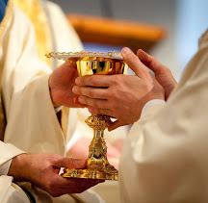
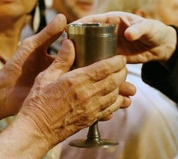
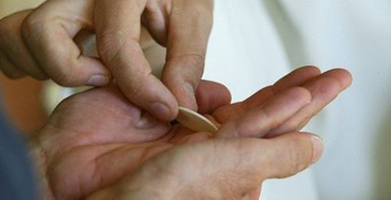
“For I received
from the Lord
what I also
handed on
to you…”
1 Corinthians 11:23
THE EXTRAORDINARY MINISTER
OF HOLY COMMUNION
Notes:
PART II
() We continue this formation for serving as an Extraordinary Minister of Communion.
During the first session, we focused on the general understanding of ministry in the Catholic tradition, we examined the role of the Extraordinary Minister of Communion, including a brief history of the ministry and finally we reviewed the requirements of the ministry. ()

Slide 2
Outline
PART II
The Liturgy
The Eucharist
Understanding of the sacrament
Walk through the Mass
Theology of the Real Presence
Notes:
In this second session, () we will cover a general understanding of liturgy in the Catholic Church, () and then we will focus on the celebration of the Eucharist, () that includes an understanding of the sacrament, () a walk-through of the Mass () and a review of the theology of the Real Presence. ()

Slide 3
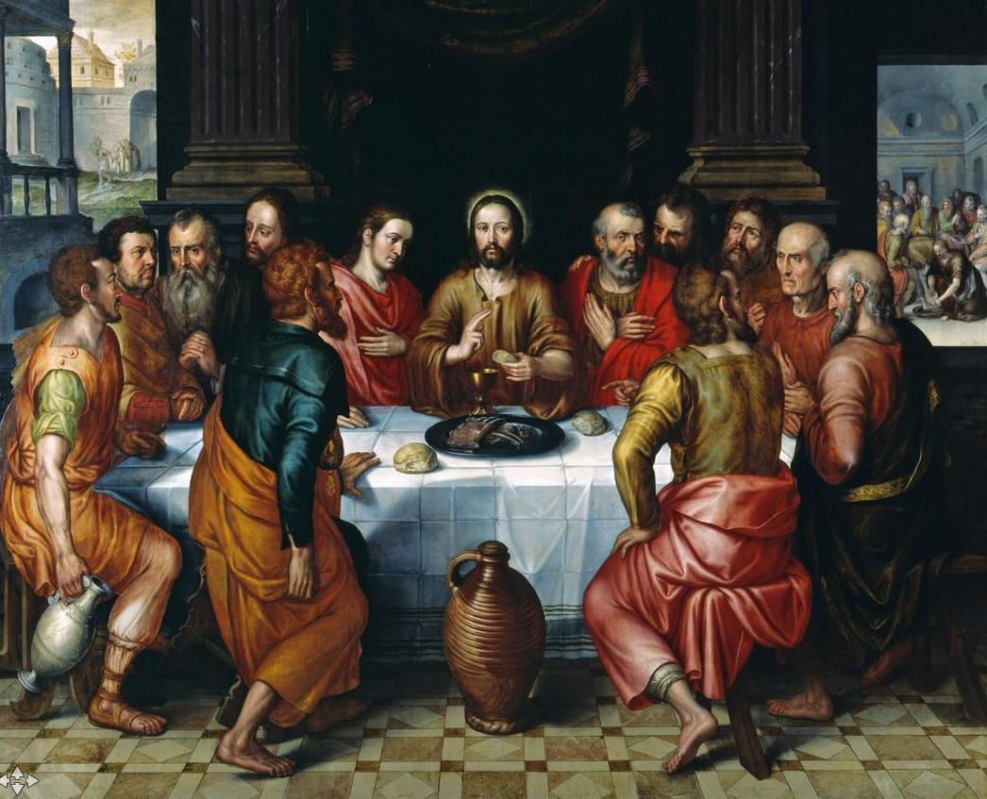
Prayer
Notes:
Let’s begin our session with prayer.
Use Extraordinary Minister of Communion Prayer 2.
Following the hymn, advanced to the next slide for the reading ()

Slide 4
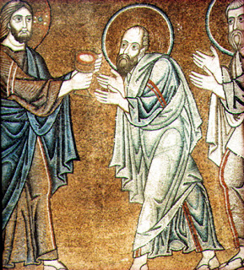
I Corinthians 11:23-26
Brothers and sisters:
I received from the Lord what I also handed on to you,
that the Lord Jesus, on the night he was handed over,
took bread, and, after he had given thanks, broke it
and said, “This is my body that is for you.
Do this in remembrance of me.”
In the same way also the cup, after supper, saying,
“This cup is the new covenant in my blood.
Do this, as often as you drink it, in remembrance of me.”
For as often as you eat this bread, and drink the cup,
you proclaim the death of the Lord until he comes.
Notes:
A reading from the first letter of Paul to the Corinthians: ()
Brothers and sisters:
I received from the Lord what I also handed on to you,
that the Lord Jesus, on the night he was handed over,
took bread, and, after he had given thanks, broke it
and said, “This is my body that is for you.
Do this in remembrance of me.”
In the same way also the cup, after supper, saying,
“This cup is the new covenant in my blood.
Do this, as often as you drink it, in remembrance of me.”
For as often as you eat this bread, and drink the cup,
you proclaim the death of the Lord until he comes.
Continue with the prayer found on the sheet.
When finished with the prayer, continue on ()

Slide 5
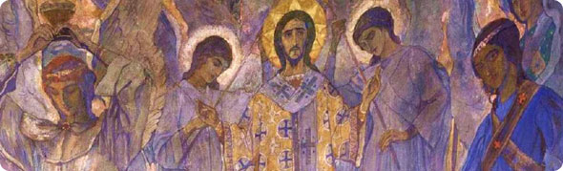
The Sacred Liturgy
Notes:
We begin by taking a look at the importance of the sacred liturgy in the Catholic Church. ()

Slide 6
The Sacred Liturgy
Catechism definition: “…the participation of the People of God in ‘the work of God.’ Through the liturgy, Christ, our redeemer and high priest, continues the work of our redemption in, with, and through his Church” (CCC 1069).
Greek word—leitourgia—meaning “work done on behalf of the people.”
“Work of God” accomplished through Christ in which we participate
Silent
Spoken
Sung
Notes:
The Catechism of the Catholic Church defines liturgy () as “the participation of the People of God in ‘the work of God.’ Through the liturgy, Christ, our redeemer and high priest, continues the work of our redemption in, with, and through his Church” (CCC 1069).
The word “liturgy” may seem like an uncommon word. () It actually is based on the Greek word, leitourgia, meaning “work done on behalf of the people” or a public service. ()
More accurately in the Catholic Tradition, liturgy is understood properly as the “work of God” accomplished through Christ in which the faithful participate through the silent, spoken and sung prayer. ()

Slide 7
The Sacred Liturgy
General term for the official public worship of the Church
The source and summit of all activity in the Church (CSL 10)
Various liturgy in the Church
Eucharist (the Mass)—first and foremost
The Sacraments
Liturgy of the Hours
Liturgy of the Word
Notes:
The word “liturgy” () is a general term for the official public worship of the Church, () and according to the Second Vatican Council document, Constitution on the Sacred Liturgy, liturgy is the source from which and the summit to which all activity in the Church flows. ()
There are various forms of liturgy in the Church: () first, and foremost is Eucharist, or the Mass. ()
All celebration of the sacraments would be examples of liturgy. ()
The Church marks time during the day through the praying of the Liturgy of the Hours. ()
And ritual in the Church that takes place within a celebration of the Word of God would be considered liturgy (Ash Wednesday, Rite of Election etc.) ()

Slide 8
The Sacred Liturgy
The Life of the Church
The work of our redemption accomplished
Express and manifest to others the Paschal Mystery of Christ
Christ is present in:
The Eucharistic elements (par excellence)
Person of the minister
In the Sacraments
In the Word proclaimed
In the Church gathered (Mt. 18:20)
Notes:
The Sacred Liturgy is vital to the life and mission of the Church, () for in it, the work of our redemption is accomplished , () and the faithful express and manifest to others the mystery of Christ and the real nature of the Church. ()
We believe that Christ is continuously present to us through the sacred liturgy, and the Constitution on the Sacred Liturgy outlines the five ways that Christ is present: ()
First and foremost, in the Eucharistic elements of the consecrated bread and wine at Mass ()
Secondly, in the person of the minister ()
Third, in the celebration of the Sacraments ()
Fourth, in the Scripture readings proclaimed ()
Finally, in the Church gathered, for Jesus tells us in Matthew’s gospel, “For where two or three are gathered together in my name, there am I in the midst of them.” ()

Slide 9
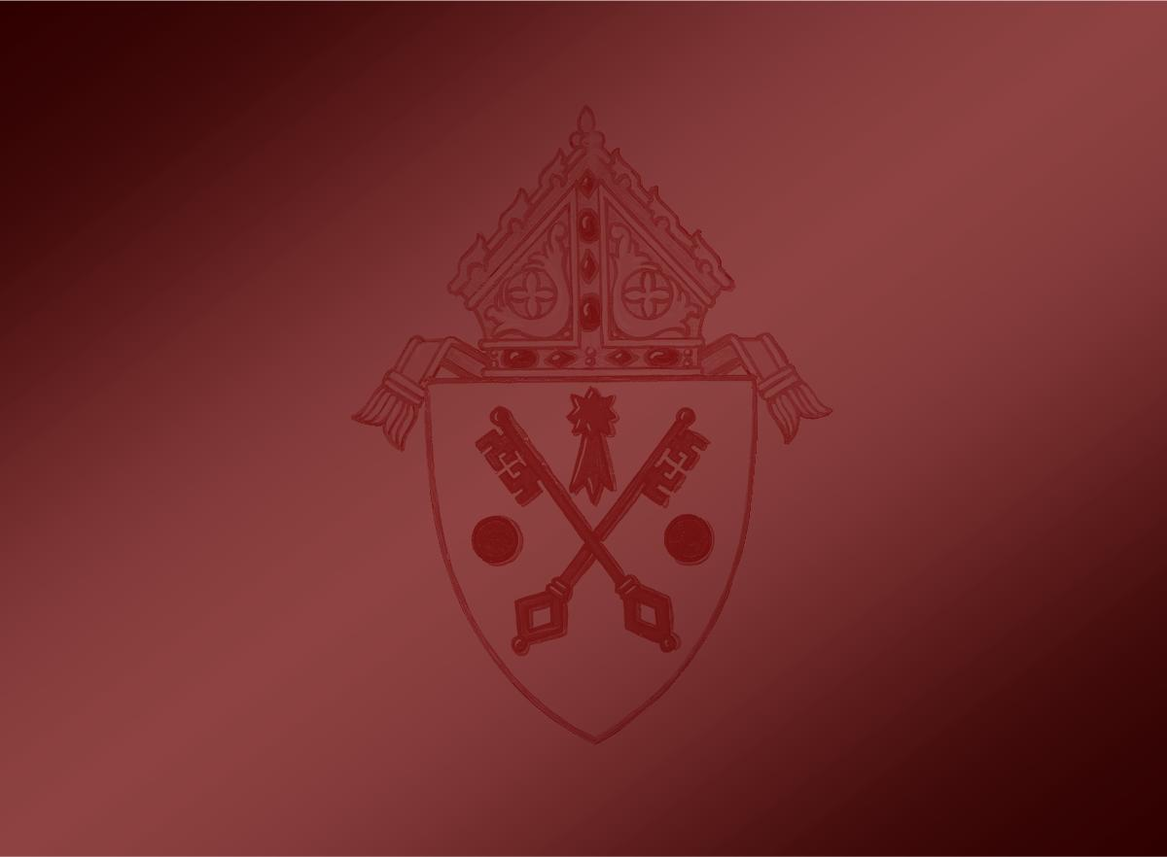
Discussion
What does the Mass mean to you?
How is it a part of your spiritual life?
Notes:
Does anyone have any questions so far?
After questions, continue on…
A question for our reflection and discussion: ()
What does the Mass mean to you? How is it part of your spiritual life?
After discussion, continue on… ()

Slide 10
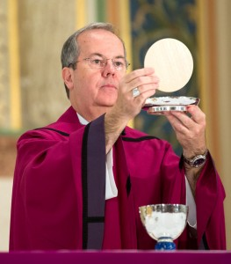
The Eucharist
Notes:
Next, we will direct our focus to the Church’s most important liturgy, the Eucharist. ()

Slide 11
The Eucharist
“The Eucharist, the sacrament of our salvation accomplished by Christ on the cross, is also a sacrifice of praise and thanksgiving for the work of creation. In the Eucharistic sacrifice the whole of creation loved by God is presented to the Father through the death and resurrection of Christ” (CCC 1359).
Notes:
The Catechism explains that () “the Eucharist, the sacrament of our salvation accomplished by Christ on the cross, is also a sacrifice of praise and thanksgiving for the work of creation. In the Eucharistic sacrifice the whole of creation loved by God is presented to the Father through the death and resurrection of Christ” (1359). ()

Slide 12
The Eucharist
Memorial & Sacrifice
“By giving us his body and blood in the Eucharist, Christ perpetuates his sacrifice on the cross and gives us a memorial of his death and resurrection until he comes again” (CSL 47).
Anamnesis (reactualization): The point of recalling to God the sacrifice of Christ that its benefits may be made present to the faithful here and now.
Real Presence
Words of Institution: “For this is my body…for this is the chalice of my blood…Do this in memory of me.”
Notes:
The Eucharist is both a Memorial and Sacrifice: ()
According to the Constitution on the Sacred Liturgy, “By giving us his body and blood in the Eucharist, Christ perpetuates his sacrifice on the cross and gives us a memorial of his death and resurrection until he comes again” (47). () This idea of “remembering” comes from the Jewish tradition where a memorial is the “recalling” to God of a past person or promise. In the Eucharist, we call this the Anamnesis, which is the point of recalling to God the sacrifice of Christ that its benefits may be made present to the faithful here and now. Thus, Christ’s death and resurrection are forever memorialized and made present through the Mass. We express this whenever we sing the Mystery of Faith: “When we eat this bread and drink this cup, we proclaim your death, O Lord, until you come again.” ()
The Eucharist is also the Real Presence of Christ, () for we recall in the words of Institution, “For this is my body…For this is the chalice of my blood…Do this in memory of me.” ()

Slide 13
The Eucharist
Thanksgiving and Unity
“They (the faithful) should be instructed by God’s word and be nourished at the table of the Lord’s body; they should give thanks to God; by offering the immaculate Victim…they should be formed day by day into an ever more perfect unity with God and with each other, so that finally God may be all in all” (CSL 48).
Future Glory
“In the earthly liturgy, we take part in a foretaste of that heavenly liturgy celebrated in the holy city of Jerusalem toward which we journey as pilgrims…” (CSL 8)
Notes:
Eucharist is also a thanksgiving and a sign of our unity. () The Constitution on the Sacred Liturgy states that “the faithful should be instructed by God’s word and be nourished at the table of the Lord’s body; they should give thanks to God; by offering the immaculate Victim…they should be formed day by day into an ever more perfect unity with God and with each other, so that finally God may be all in all” (48).
The very word Eucharist comes from the Greek word, eucharisteo, meaning “to give thanks”, and the sense of unity is expressed throughout the Mass from the singing of the Entrance Hymn to the Sign of Peace, and to the reception of Holy Communion itself. ()
The Eucharist also gives us a taste of our future glory in heaven: () “In the earthly liturgy, we take part in a foretaste of that heavenly liturgy celebrated in the holy city of Jerusalem toward which we journey as pilgrims…” (CSL 8) ()

Slide 14
The Eucharist
As a sacred meal
Jesus extended table fellowship with saints and sinners
Began as a formal meal in the Jewish tradition
Eucharist strongly connected to the community and living the Christian life
“You Are What You Eat” = The Body of Christ
Be Christ to those in the world
Notes:
We also understand the Eucharist as a sacred meal among the faithful, and the origins of this understand were presented in the last session. ()
From the gospels, we see over and over again that Jesus extended table fellowship with saints and sinners in building up the Kingdom. ()
We learned that the Eucharist began as a formal meal in the Jewish tradition. ()
Finally, we learned how in early Christianity, the Eucharist was strongly connected to the community and living the Christian way of life. () Recall the “You Are What You Eat” statement by St. Augustine () and the missionary aspect it entails—to be Christ to those in the world. ()

Slide 15
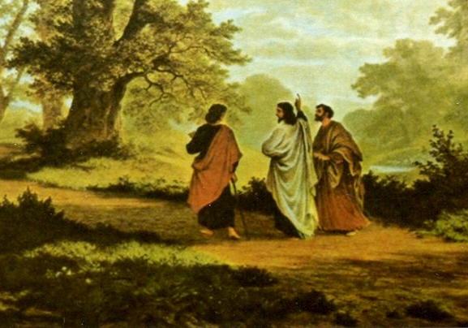
The Road to Emmaus
Luke 24:13-35
Best summarizes what we do when we gather for Eucharist
Take, Bless, Break, Give
Notes:
In summarizing all of these theological aspects of the Eucharist, please listen to the story of “The Road to Emmaus” found in Luke’s gospel. () (Luke 24:13-25) ()
This passage that most of us are very familiar with best summarizes what we do when we gather for Mass:
1. We come together on that first day of the week while on a journey.
2. We come as we are, full of our joys, gratitude, struggles, pains, worries, doubts and we present them to God.
3. We listen to God speak to us through his Word, and the minister “breaks open” that Word to bear fruit in our lives ()
4. We take bread, it is blessed, it is broken and it is given to us.
5. We recognize that Jesus is truly present to us in this great sacrament.
6. We depart to “announce the Gospel of the Lord.” ()

Slide 16
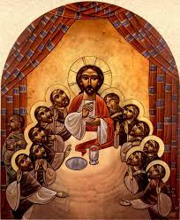
A
Walk through the Mass
Notes:
During this next part, we will take a closer look at each part of the Mass so that we can have a better understanding and appreciation for what we do when we gather to celebrate Eucharist. ()

Slide 17
A Walk through the Mass
Introductory Rite
Entrance Chant
Sign of the Cross & Greeting
Penitential Act or Sprinkling Rite
The Kyrie (omitted if already incorporated into Penitential Act or if the Sprinkling Rite is used)
Gloria
The Collect
Notes:
The first part of Mass is called the Introductory Rite, which “introduces” and prepares us for the sacred mysteries we are about celebrate. () It consists of the Entrance Chant, or song, whose “…purpose is to open the celebration, foster the unity of those who have gathered, and introduce their thoughts to the mystery of the liturgy time or festivity, and accompany the procession of the Priest and ministers” (GIRM 47). ()
Next is the Sign of the Cross and Greeting by which the “mystery of the Church gathered together is made manifest” (GIRM 50). () Immediately following is the Penitential Act in which the faithful are invited to call to mind their sins, and ask the Lord for mercy. There is always an option on Sundays for the priest use the Sprinkling Rite as a reminder of our Baptism in place of the Penitential Act. () Unless it was already part of the Penitential Act, the Kyrie (Greek for “Lord”), or Lord, Have Mercy is sung or said, acclaiming the Lord and imploring his mercy. ()
Then the Gloria, or Glory to God, which is an ancient hymn in which the Church, gathered in the Holy Spirit, glorifies and entreats the Father and the Son. This great hymn is sung on Sundays, solemnities and feasts of the Church except on the Sundays of Advent and Lent. ()
Finally, the priest invites everyone to pray (“Let us pray.”) and pauses in silence (allowing them to pray) and “collects” the silent prayers together by voicing one prayer aloud to God the Father, through Christ, in the Holy Spirit. It is from this idea of “collecting” the silent prayers of the faithful that this prayer is called the “Collect.” ()

Slide 18
A Walk through the Mass
The Liturgy of the Word
First Reading—usually taken from the Old Testament
Responsorial Psalm
Second Reading—taken from one of the Epistles (letters)
Notes:
Everyone is seated for the next part of the Mass, () the Liturgy of the Word, where God speaks to his people and opens our hearts and minds to the mystery of our salvation in Christ. ()
The First Reading is usually taken from the Old Testament, although during the Easter season it is taken from the Acts of the Apostles. We usually hear some connection between the First Reading and the Gospel reading at each Mass. ()
The Responsorial Psalm follows and usually corresponds to the First Reading. While normally taken from the collection of Psalms, occasionally it is a canticle or song from another part of Scripture. It is usually sung by the cantor or psalmist with a response sung by the faithful. ()
The Second Reading, usually only read on Sundays and solemnities, comes from one of the epistles, or letters, in the New Testament. Over the course of Sundays, the Second Reading may be a continuous reading of one of the epistles, so it may not have a direct connection with the other readings at Mass. ()

Slide 19
A Walk through the Mass
The Liturgy of the Word
First Reading—usually taken from the Old Testament
Responsorial Psalm
Second Reading—taken from one of the Epistles (letters)
Acclamation before the Gospel (Alleluia)
Gospel Reading
Homily
Profession of Faith
The Universal Prayer (Prayer of the Faithful)
Notes:
Next, we reach the high point of the Liturgy of the Word—the Reading of the Gospel. In the liturgy we treat this moment with great respect and honor when everyone stands, the Book of the Gospels is carried in procession and the Alleluia acclamation is sung. This Hebrew word means “praise God” and is usually associated with Easter. For that reason, we refrain from its use during Lent in anticipation of Easter joy, and substitute an alternate acclamation. ()
Following the acclamation, the priest or deacon then reads a passage from one of the Gospels that usually tells an event in the life of Jesus or recalls one of his parables or teachings. During this reading, we acknowledge that Christ is present and is speaking to us here and now. ()
Immediately following the Gospel Reading, the faithful are seated and the priest or deacon offers the homily which is a necessary component for nurturing the Christian life. In it, the minister “breaks open” the Word of God that we have just heard so that we may better hear and understand the voice of Christ in our lives. ()
After we have listened attentively, we all stand and make a Profession of Faith which is a long statement about the great mysteries of our faith including our beliefs in the Holy Trinity and the Church. ()
Finally, we respond to the Word of God proclaimed and the faith we have professed by offering the Universal Prayer. Also known as the Prayer of the Faithful, these intercessions express our concern for the entire Catholic Church, the needs of the world, our nation, the poor, our community, the sick and for those who have died. ()

Slide 20
A Walk through the Mass
Liturgy of the Eucharist
Preparation of the Gifts
Prayer over the Offerings
The Eucharistic Prayer
Preface (Thanksgiving)
Sanctus acclamation
Epiclesis
Institution Narrative
Anamnesis
Oblation
Intercessions
Concluding Doxology and Amen
Notes:
Mass then transitions into the second part, () known as the Liturgy of the Eucharist. () During this transition called the Preparation of the Gifts, the altar is prepared and the offerings of the faithful are collected. These, along with the gifts of bread and wine, are brought forward to the altar, symbolic of the offering our lives. The priest then prepares the gifts of bread and wine for the consecration. () This period of preparation concludes with the Prayer over the Offerings.
Next, we move into the center and high point of the entire Mass: () The Eucharistic Prayer. This great prayer begins with the priest inviting us to lift up our hearts to the Lord in prayer and thanksgiving. () In the Preface, the priest glorifies God for the whole or particular aspect of our salvation. () We acclaim this great act of God by joining our voices with the angels in heaven as we sing the Sanctus or “Holy, Holy Holy”. () Next, we kneel in reverence as the priest calls down the Holy Spirit in the Epiclesis to change the gifts of bread and wine into the Body and Blood of Christ. () Then we hear the Institution Narrative in which Christ gave us his Body and Blood at the Last Supper. () The Anamnesis or Memorial Acclamation, sung or recited by the faithful recalls the passion, death and resurrection of Christ as the reason why we celebrate this Eucharist. () The priest then offers this sacrifice of the Lord’s Body and Blood to the Father in the Oblation so that we might experience the effects of Christ’s sacrifice on the cross even now. () Intercessions are made in communion with the whole Church, both in heaven and on earth, () and concludes with glorifying God in the Doxology and our acclamation of Amen. ()

Slide 21
A Walk through the Mass
Liturgy of the Eucharist
Communion Rite
The Lord’s Prayer
Rite of Peace
The Fraction of the Bread
Communion (Communion Chant)
Prayer after Communion
Concluding Rite
Brief announcements
Greeting & Blessing
Dismissal
Notes:
The Liturgy of the Eucharist continues with the Communion Rite. ()
Together we stand, and pray together the words that Jesus taught us, in the Lord’s Prayer. () In the Rite of Peace, the priest prays for peace and unity in the Church and for all of humanity, and we express a gesture of peace to each other as a sign of our communion and charity before receiving the Lord’s Body and Blood. () During the Fraction of the Bread, the Lamb of God (Agnus Dei) is sung, and the consecrated bread is broken, just as Christ did at the Last Supper, and signifies that we, the faithful, belong to the one Body of Christ. () The priest then invites us to participate in this Communion, and the Communion Chant or song is sung by all the communicants as a means of expressing our spiritual union with each other as we receive this great sacrament.
Once the distribution of Communion is over, all pray quietly, reflecting on the sacrament they have just received (). All stand and the priest offers the Prayer after Communion to conclude the Communion Rite. ()
The Concluding Rite () includes any brief announcements (if necessary), () the greeting by the priest, and the blessing which may be given in various forms. () The faithful are then dismissed by the deacon or priest to go forth to do good works and to praise and bless God. It is customary, but not necessary to sing a hymn after the dismissal. ()

Slide 22
The Real Presence
Ordinary elements of bread and wine become the Body and Blood of Christ
Christ is truly present to us in bread and wine, given to us by God as spiritual food and drink, which is our sustenance so that we can be dismissed to carry on the work of Christ’s body
The Sacramental Body of Christ makes us the Ecclesial Body of Christ, and the Ecclesial Body of Christ offers the Sacramental Body of Christ.
Transubstantiation—having the accidents of bread and wine but having the substance of the Body and Blood
Having reverence for the care of this sacrament both during and outside Mass.
Notes:
Finally, it is important to review all of the key points presented already about our Catholic understanding of the Real Presence of Christ in the Eucharist.()
Fundamentally, the teaching of the Real Presence is that ordinary elements of bread and wine become the Body and Blood of Christ at Mass. () Christ is truly present under the appearance of bread and wine, and is given to us by God as spiritual food and drink so that we can be sustained in carrying out the work of Christ’s Body in the world. () Thus, the sacramental Body of Christ that we receive in Holy Communion builds us up as the ecclesial Body of Christ, or the Church, and in turn, the Church offers the sacramental Body of Christ to the Father for our salvation. ()
As far as the senses perceiving the Lord’s Body and Blood as simply bread and wine, St. Thomas Aquinas in the Middle Ages developed the doctrine of transubstantiation, which states that although the Eucharist has the accidents or physical attributes of bread and wine, the substance or the reality of it is the true Body and Blood of Christ. ()
Because of this central teaching of the Catholic faith, we must show great reverence and utmost care for this sacrament both during and outside of Mass. ()

Slide 23
Discussion
Why do you think Jesus gave us
his Body and Blood in the Eucharist?
Do you think his Church would have survived
if he didn’t give us this Sacrament?
Notes:
Does anyone have any questions?
After questions, continue on… ()
Questions for our reflection and discussion: ()
Why do you think Jesus gave us his Body and Blood in the Eucharist? ()
Do you think his Church would have survived if he didn’t give us this great Sacrament?
After discussion, and if time allows, continue with the practicum.

