Slide 1
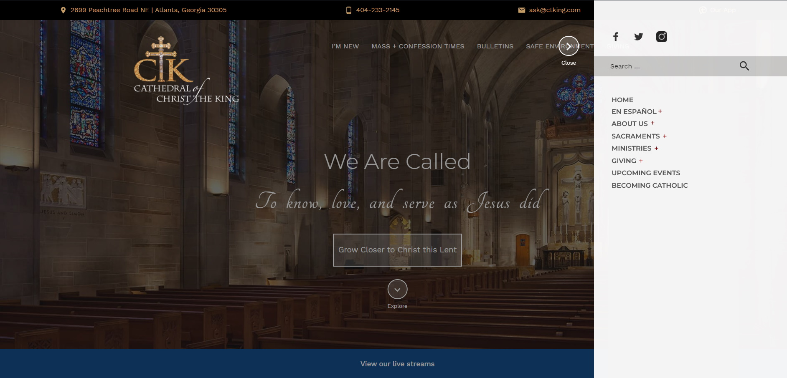

Slide 2
Home
En Español
[remains the same]
About Us
Mass Times
Bulletin
Clergy Staff
Contact Us
Join Us + Forms
Safe Environment
History
Get Involved
Family+Children
Young Church
Adult
Recreation
Sacraments
Baptism
Eucharist
Confirmation
Marriage+Weddings
Anointing of the Sick
Funerals
Request a Record
Giving
Offertory
Gifts of Stock
Legacy Gift
Annual Reports
Upcoming Events
Becoming Catholic

